Slide 1
24th National Children’s Science Congress – 2016 Theme Science,Technology,Innovation for Sustainable Development
Y.B.Kannan
Assistant Professor of Physics
Arumugam Pillai Seethai Ammal College
Tiruppattur – 630211
8870 7870 42

Slide 2
Food and Agriculture for Sustainable Development

Slide 3
Meaning of sustainable development
Meets the needs of the present,
without compromising the ability of future generations to meet their own needs.

Slide 4
Basic Problem

Slide 5
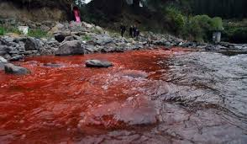
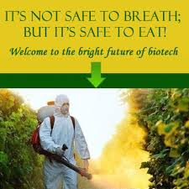
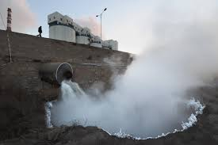
Problems affecting sustainable development - 1
Farmers woes

Slide 6
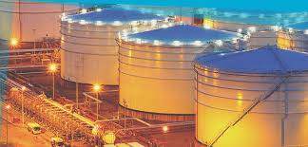
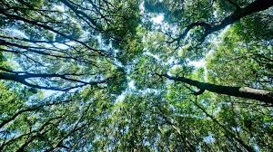
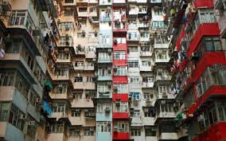
Problems affecting sustainable development - 2
Deforestation

Slide 7
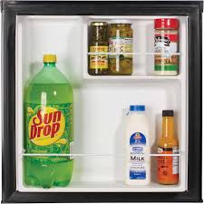
Modern Gadgets

Slide 8
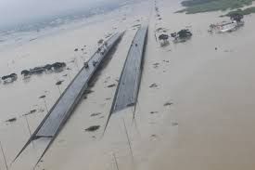
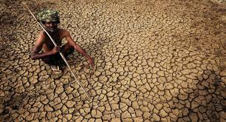
Problems affecting sustainable development - 3
Global warming

Slide 9
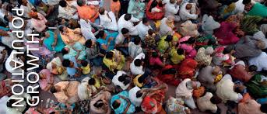
Problems affecting sustainable development - 4
Growth in world population

Slide 10
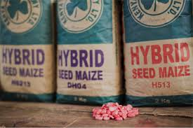
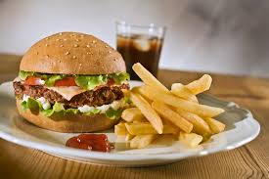
Problems affecting sustainable development - 5
Globalization – world politics

Slide 11
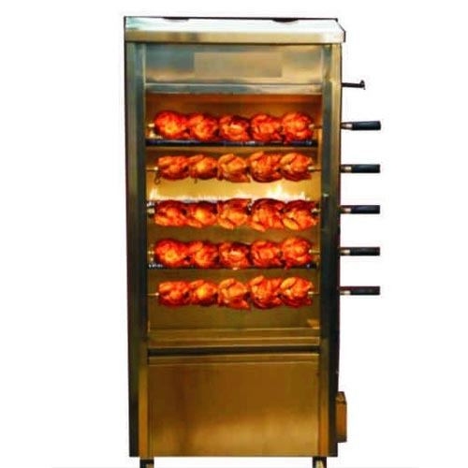
Problems affecting sustainable development - 6
Modernization – unwanted health problems

Slide 12
Problems affecting sustainable development
Farmers woes
Soil quality, pesticides,
Global warming
Climatic change
Flood and drought
Deforestation
Urbanization
Industrialization
Globalization
International politics
Junk food
Growth in population
Nucleus family

Slide 13
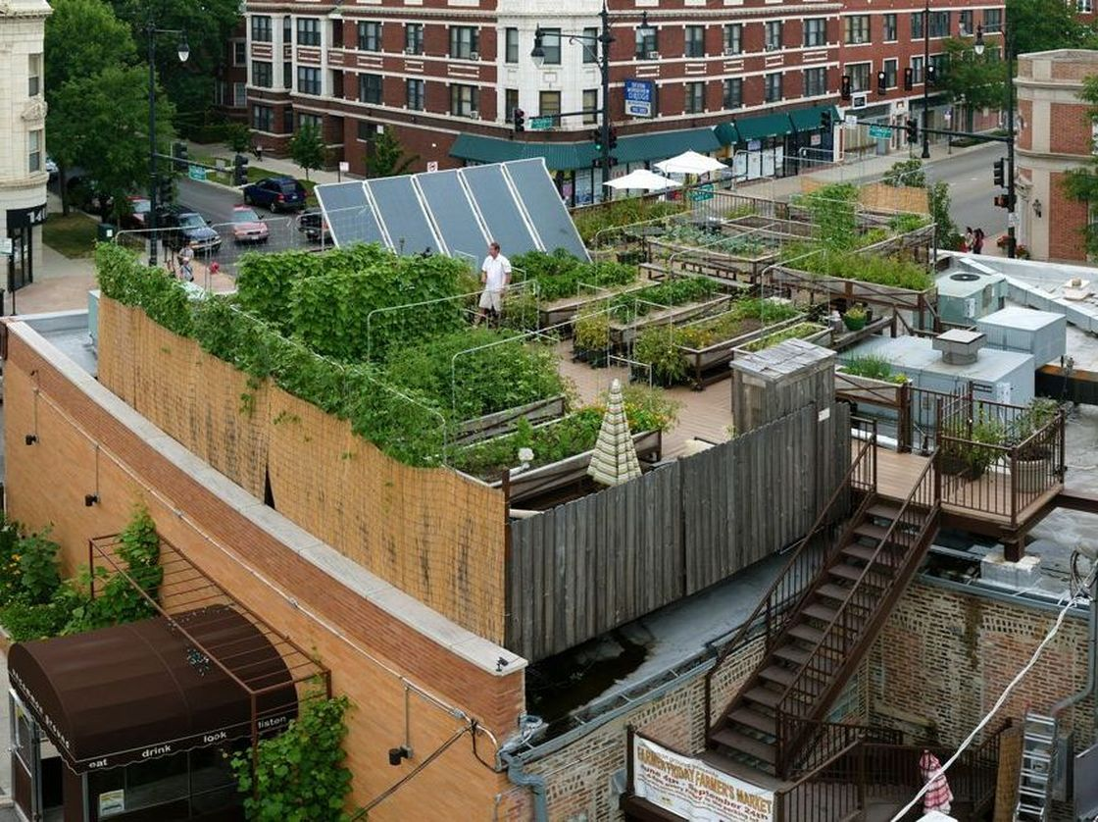
Problem solving! - Roof top garden

Slide 14
Why not roof top paddy field?

Slide 16
Hint from Nano technology

Slide 17
Nano Agriculture – may be a solution!
No Tractor – only bull

Slide 18
Rooftop Paddy Field
By Aswathi Krishna 27th December 2014
KOCHI: Roof-top farming may not be something new to people, but 56-year-old Keerthi Chandran’s farming methods may amuse even innovative farm enthusiasts. Atop his house and at a building constructed adjacent to it at Karikandan Para, Kozhikode, he grows all kinds of vegetables, along with paddy.

Slide 19
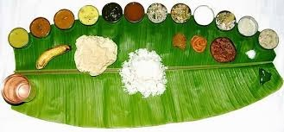
Importance of food
Sufficient and variety of foods - meet their nutritional needs.
Food is any substance, composed of carbohydrates, water, fats and/or proteins, that is either eaten or drunk by any animal, including humans, for nutrition or pleasure

Slide 20
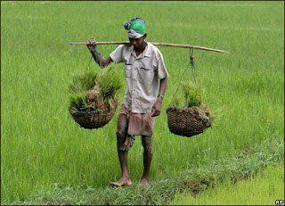
Agriculture
The science, art or practice of cultivating the soil, producing crops, and raising livestock and in varying degrees the preparation and marketing of the resulting products

Slide 22
வேளாண்மை, புராதனத் தொழில் - இன்று புறக்கணிக்கப்பட்ட தொழில்....
வேளாண்மை செய்பவனை மேலாண்மை செய்பவன் மிதிக்கிறான்.
ஆ.திருநாவுக்கரசன்

Slide 23
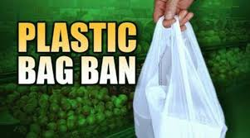
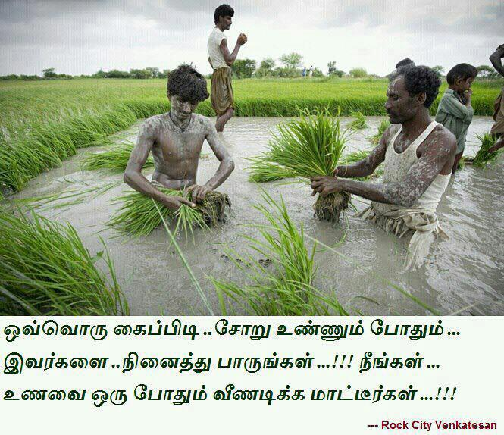
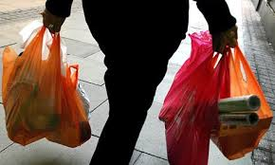

Slide 24
Need of the hour is !
Quality soil
and
Water with minerals

Slide 25
Why need soil test?
Soil fertility in Tamil Nadu reduced by half in 30 yrs, says govt paper
The Times of India , Jun 17, 2015.

Slide 26
Why fertility of soil is decreasing ?
Organic content is reducing
Indiscriminate fertilizer and pesticide usage
Non-application of cow dung and dead plant

Slide 27
Desirable level of organic carbon in soil is 0.8 – 1.3 %.
In 1971 it was 1.2% and in 2002 it was 0.68%
Very worst is Madurai – 0.23 %
Krishnagiri – 0.36%
Erode and Velore above ideal limit 4.04 & 4.2% respectively.

Slide 28
Organic content
Humus – decaying plant, earth worms, dead animals, micro organisms.
Earthworms indicators of soil health – Guindy National Park has low count.

Slide 29
Healthy soil
Healthy soil ideally has
25% air
5 – 10% of living organisms
And remaining are organic matter
Fertilizer is nothing but salt
These salt prevents growth of micro organisms.

Slide 30
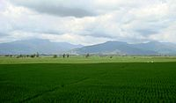
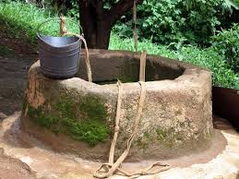
Pesticides Effects
Chemical fertilizers percolate into ground and affects the quality of ground water not only in chemical farms but also nearby by organic farms.

Slide 31
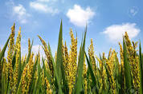
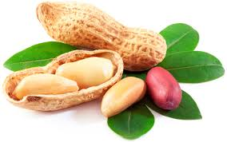
To keep healthy soil
Rotate crops to keep soil healthy
Paddy followed by legumes – peanut

Slide 32
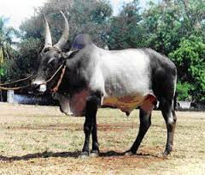
Bull instead of tractor
urine and dung provides nutrients.

Slide 33
Ideas – Soil Testing
1. Get a trowel and a bucket. Be sure neither is rusty or made of galvanized (zinc-coated) metal, which could skew your results.
2. Scrape mulch and leaf litter from the soil surface. Dig out a wedge of soil about 6 to 8 inches deep, and set this wedge aside.
3. Now dig out a half-inch piece of soil from the hole and pour it into your bucket.
4. Repeat steps 2 and 3 at least a half-dozen times in different parts of the farm or garden so that the soil sample represents your whole garden when mixed.
5. Use your trowel to mix the soil together thoroughly.
6. Fill the soil sample bag or container with the mixed soil, complete the paperwork and mail it all off to the lab.

Slide 34
Video link – You tube
www.youtube.com/watch?v=MhSfvTcsvSk

Slide 35
Ideas – Soil Testing
Soil with pH of 7is neutral
Less than 7 is acidic
Greater than 7 is alkaline
Potassium, phosphorus, magnesium, calcium, sulfur, lead and micronutrients

Slide 36
pH values
Paddy pH 5.5 – 8.5
Maize pH 7.5 – 8.5 not much water is needed
Pulses pH 5.5 – 7 with water storage
Soyabean – 6.5 – 7.5 with good drainage water facility
Ground nut 6 – 6.3 with good calcium and drainage of water.

Slide 37
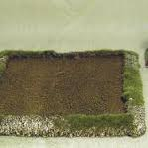
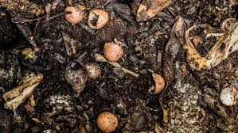
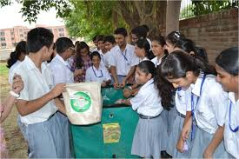
School work instead of Home work

Slide 38
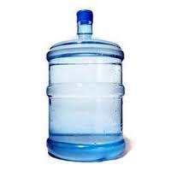
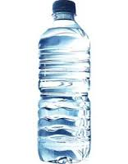
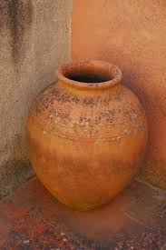
Minerals Testing - Water

Slide 39
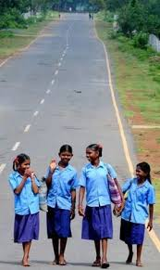
Health of school students
FOOD HABITS -MILLETS/JUNK FOOD
CONSUMPTION OF WATER - COKE/BUTTER MILK
STUDENTS WEARING SPECS, HEIGHT WEIGHT

Slide 40
More suggestions
Interview leading farmers in and around your area and compare the similarities.
Crop Storage Center visit - merits & Demerits
Make enquiry about expiry dates, ingredients etc among the parents
Availability of healthy foods in villages

Slide 41
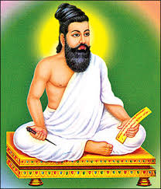
“sustain” – not new to us
பருவத்தே பயிர் செய்

Slide 42
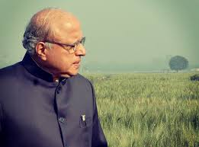
THANK YOU

