Slide 1
NATIONAL CHILDREN SCIENCE CONGRESS HEALTH, HYGIENE AND NUTRITION
MR. N. VIJAYANAND
DEPARTMENT OF BOTANY
ARUMUGAM PILLAI SEETHAI AMMAL COLLEGE
THIRUPPATHUR

Slide 4
HYGIENE - INTRO

Slide 5
Factors affecting hygiene
Cultural / Religious
Developmental Stage
Mobility
Emotional
Physical Illness
Personal Preference

Slide 7
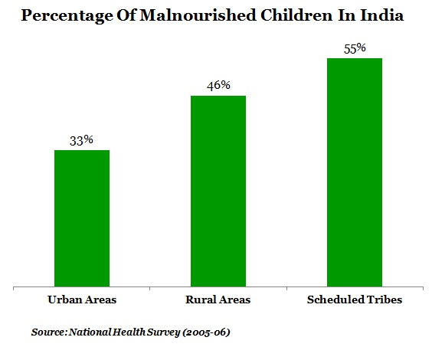

Slide 8
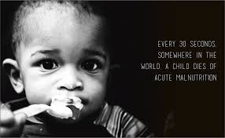

Slide 9
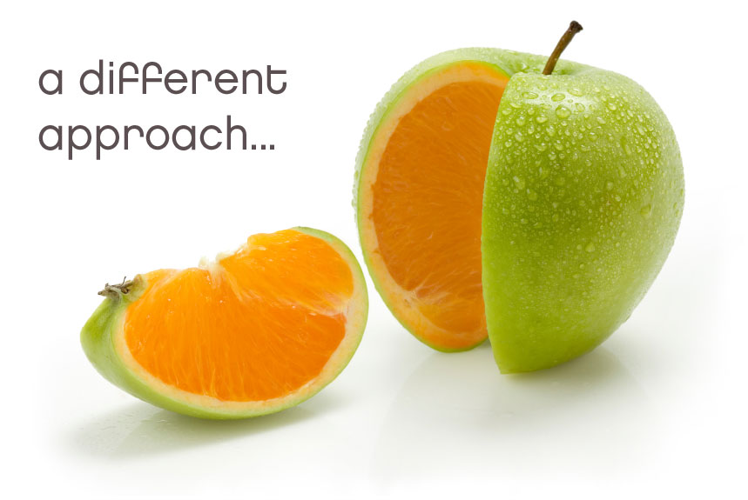
Sources for projects?
Around you? Yes means?
Near you? yes
It is Within you

Slide 10
OUTLINE
Observations
Information gathering
Title
Purpose
Hypothesis
Procedure
Materials and methods
Data or result
Conclusion

Slide 11
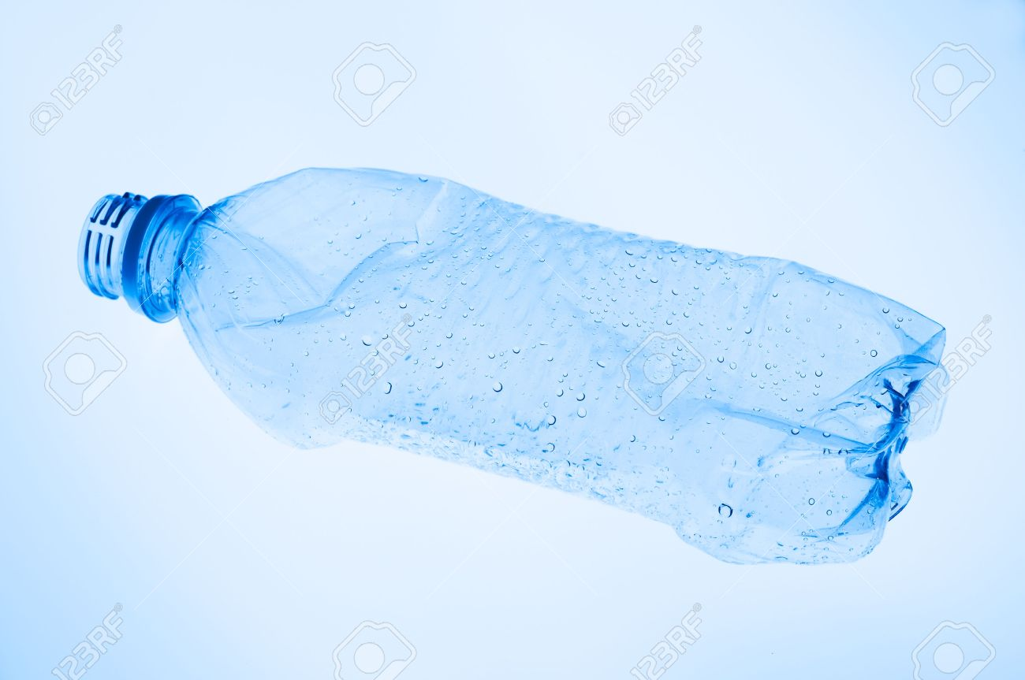
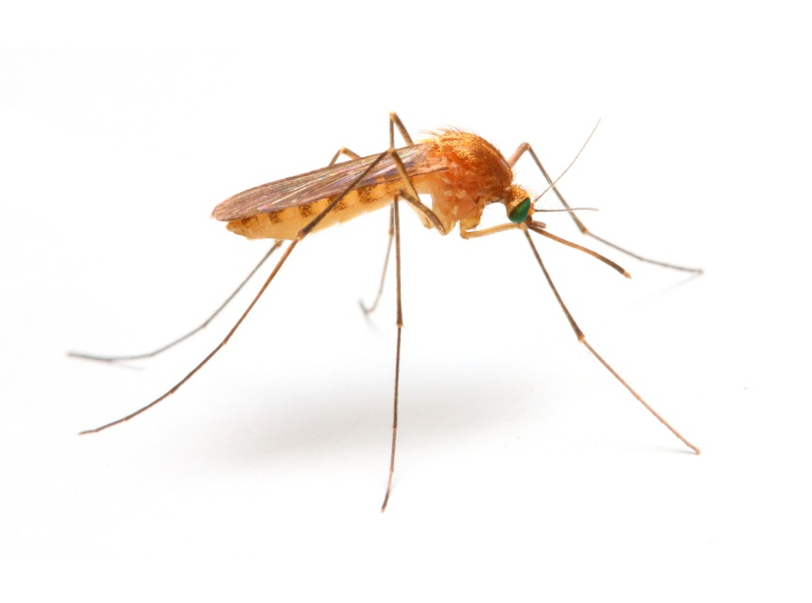
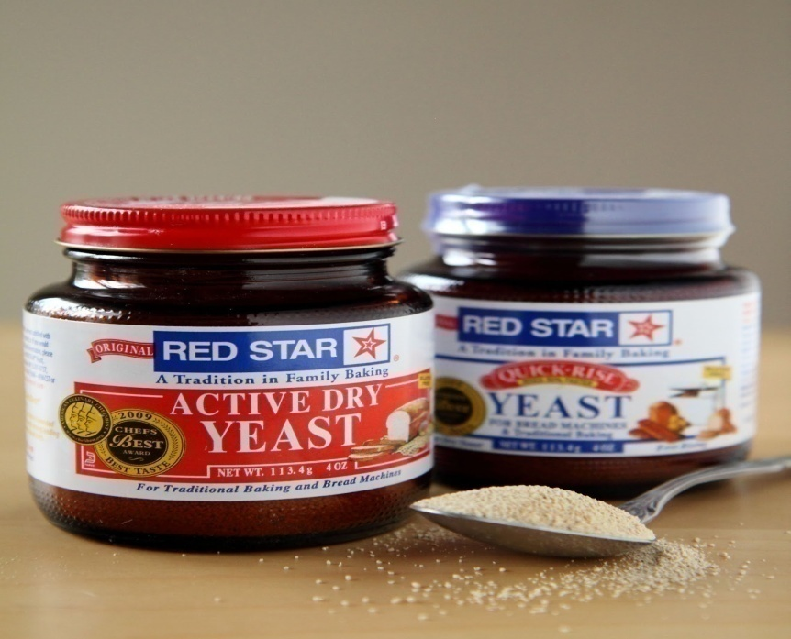
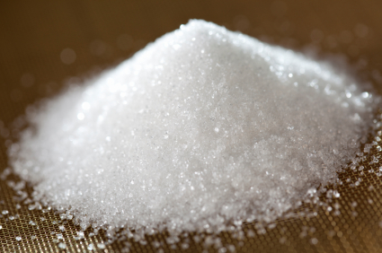
PROJECT 1

Slide 12
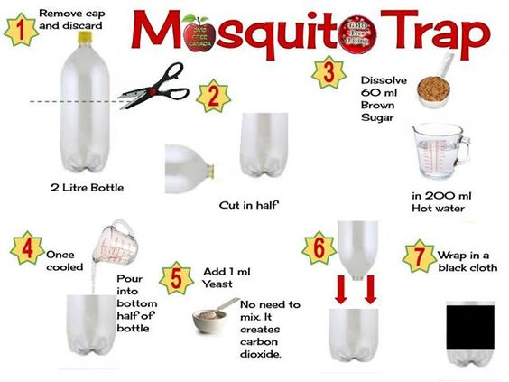
ECOFRIENDLY MOSQUITO CATCHER

Slide 14
BACKGROUND
Eco friendly
Costly
Liquid can be easily replaced

Slide 15
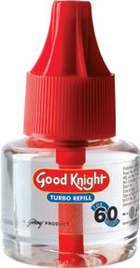
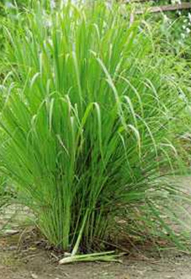
sources
T1 = Lemon grass
T2= Commercial repellent
T3 = Garlic paste
T4 = Herbal – citronella oil
T5 = Yeast + Sugar

Slide 16
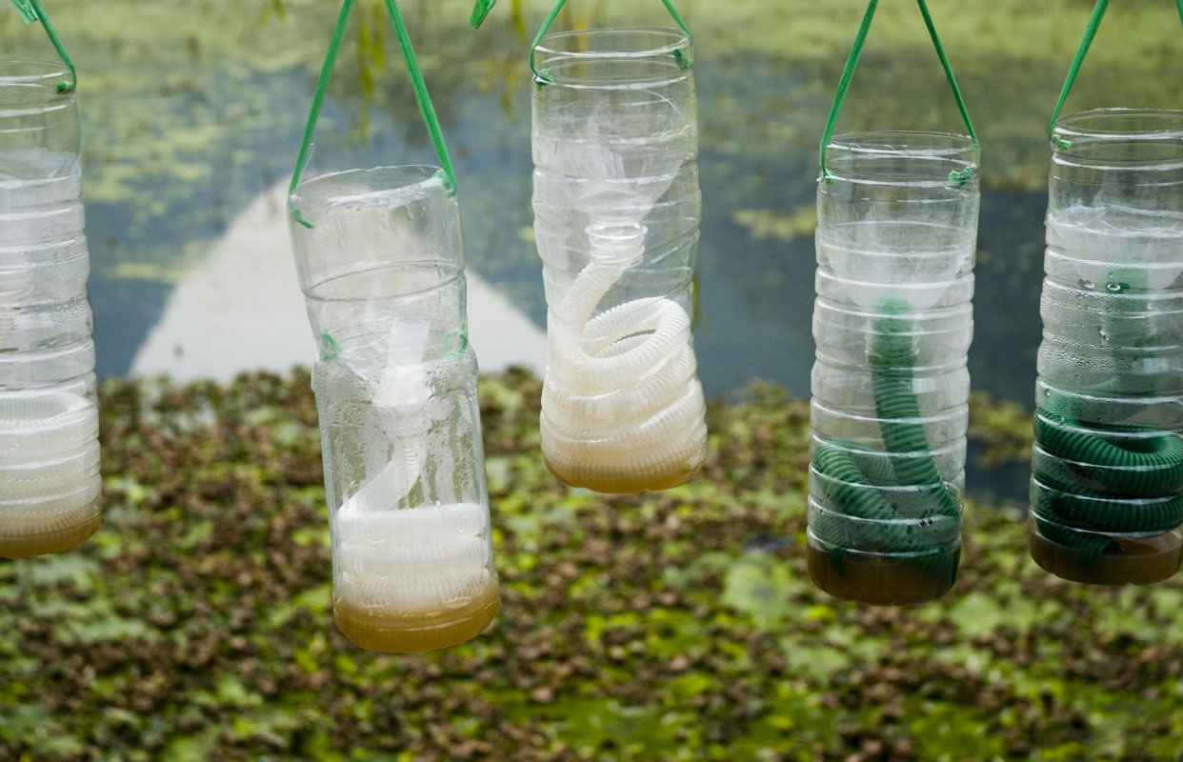

Slide 17
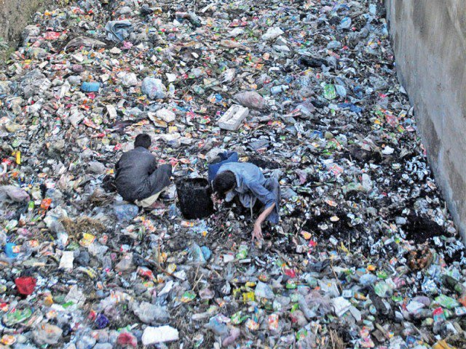
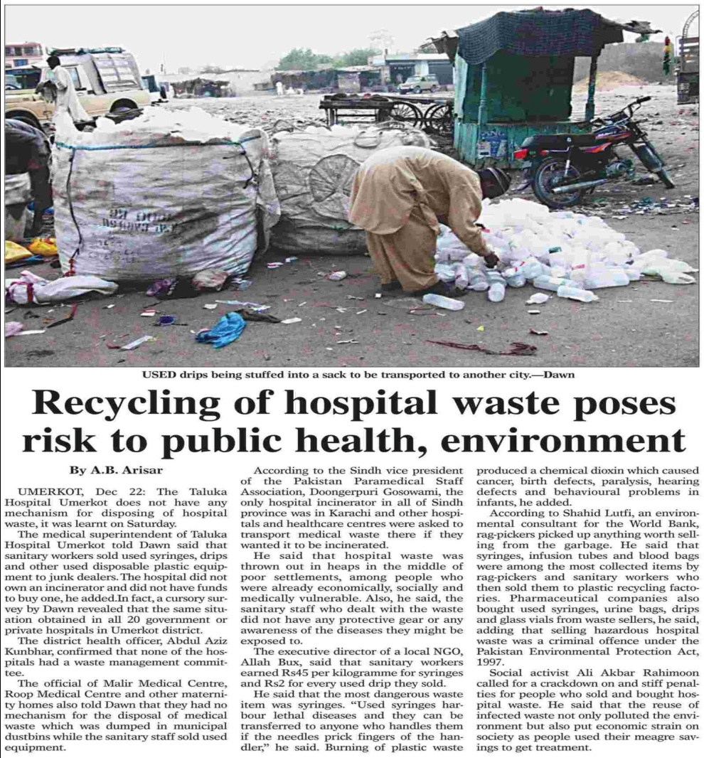

Slide 18
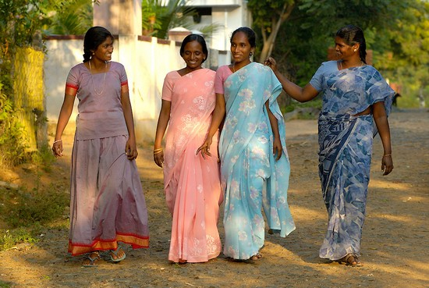
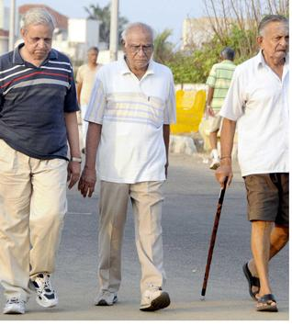
PROJECT II

Slide 19
10,000 steps a day
Apps are there
Compare with non walkers
Office characters
Peak hours in your house
Managing the peak hours
Behavior with others

Slide 21
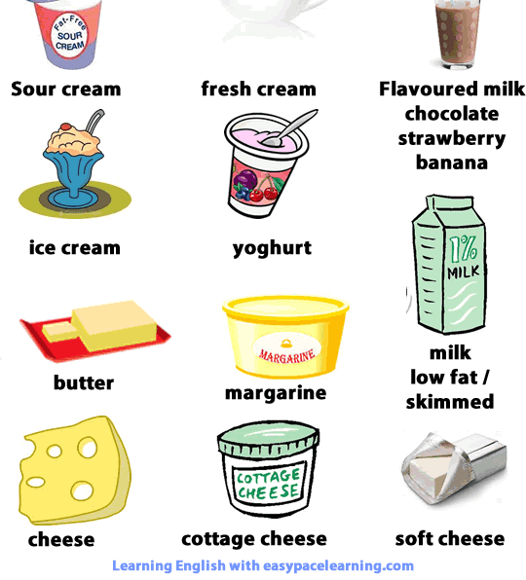
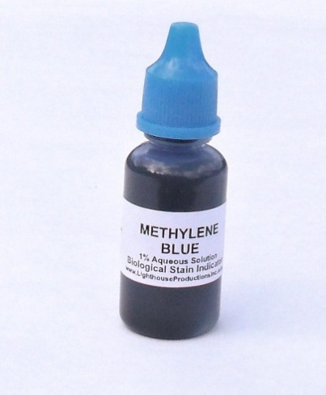
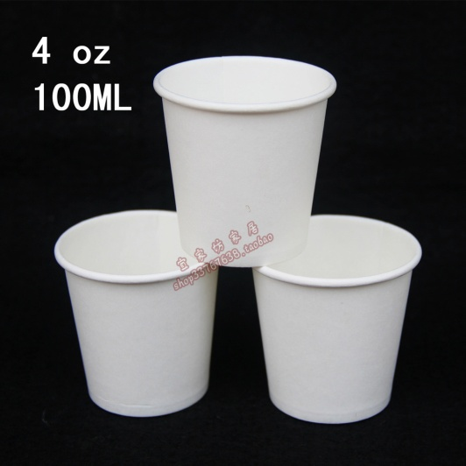
IS IT BLUE

Slide 22
Small cups
12 drops of methylene blue
Pipette
10 ml of _________
10 ml of ___________
10 ml of ___________
10 ml of __________
10 ml of __bioproduct/herbal

Slide 23
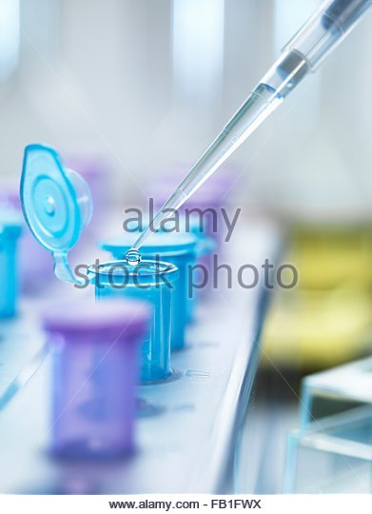
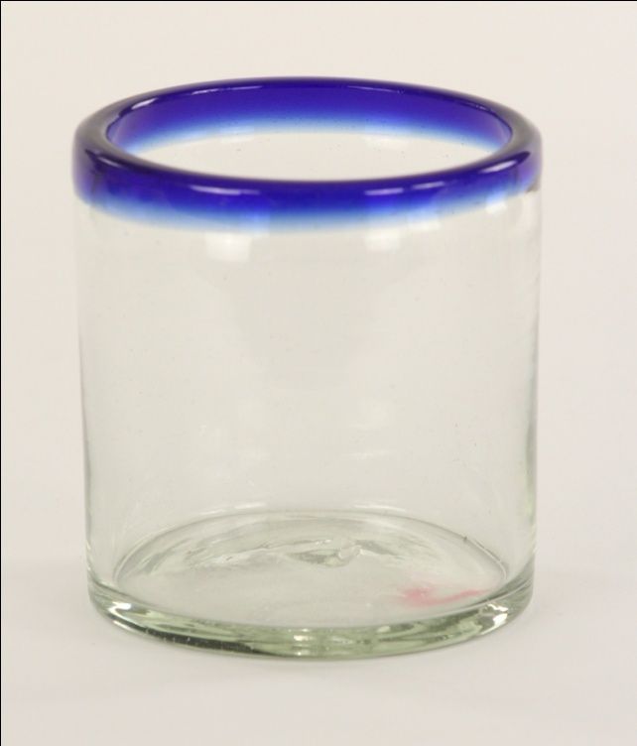
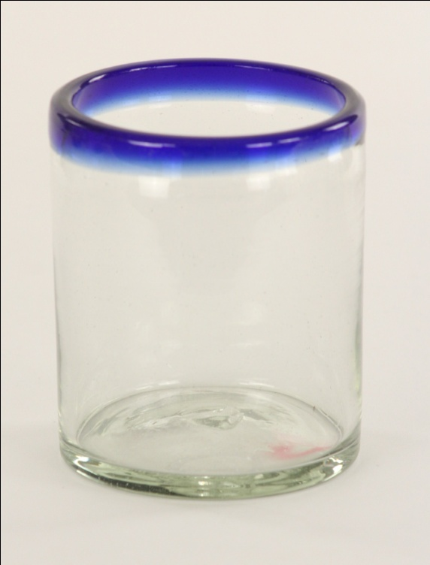

Slide 24
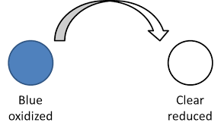
WAIT FOR 15 MINUTES
BLUE COLOUR WILL
APPEAR
Observe the time when it
goes to original colour
more than 8 hours - excellent.
takes 5.5 to 8 hours - 0.5 million organisms/ml.
takes 2 to 5.5 - 4 to 20 million organisms/ml.
If it takes less than 20 minute ,then there are over 20 million organisms only
Record your results in the form of graphs and take photos.

Slide 26
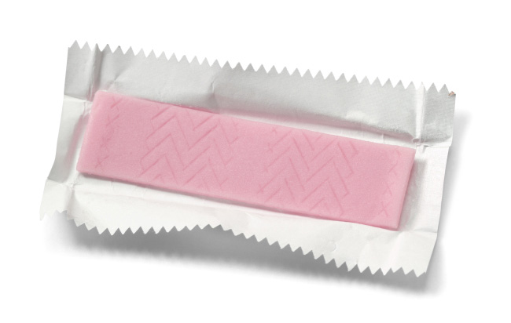
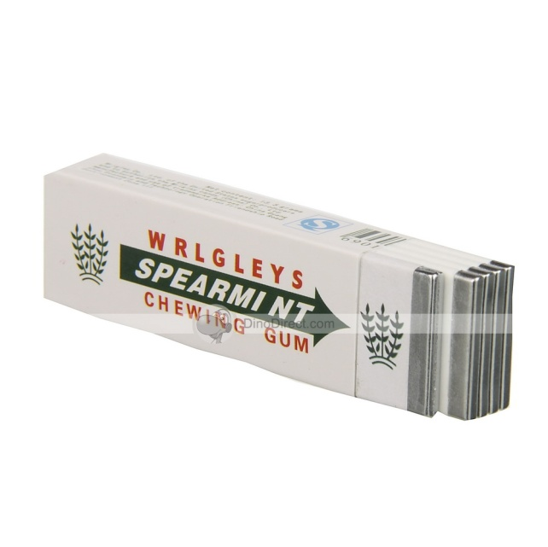
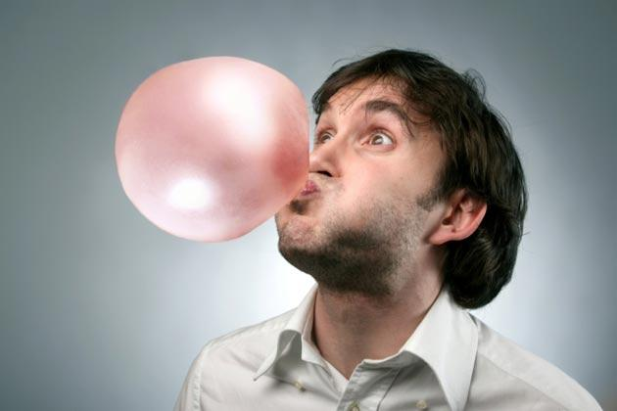
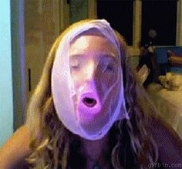
Project III

Slide 27
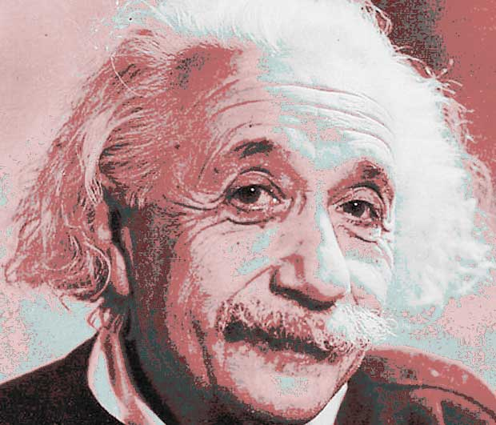
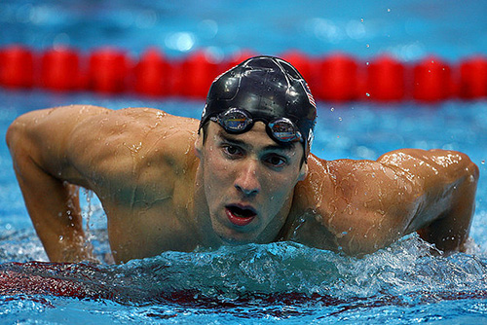

Slide 28
Attention Deficit Hyperactivity Disorder

Slide 29
CONCENTRATION
Computer, printer, and paper
Pencils for test-taking
Chewing gum
Timer Test subjects Paper and pencil for recording and analyzing data

Slide 30
Procedure
Write and print copies of two simple subtraction worksheets.
Subjects 1 = should chew gum while doing ONE of the worksheets.
Subjects 2 = without chewing gum doing worksheets
Record how long it took each subject to complete each worksheet.
Score the worksheets
Analyze your results.

Slide 31
conclusion
Did chewing gum increase people’s speed and accuracy on subtraction tests?
Try the experiment in different environments.
(e.g. noisy, crowded, or otherwise distracting environments)?
certain ages or genders?
certain times of day (e.g. early morning or late afternoon)?
before or after certain activities (e.g. just before lunchtime or after physical exercise)

Slide 32
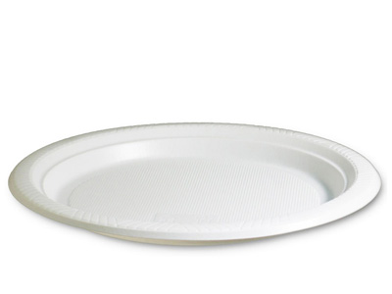
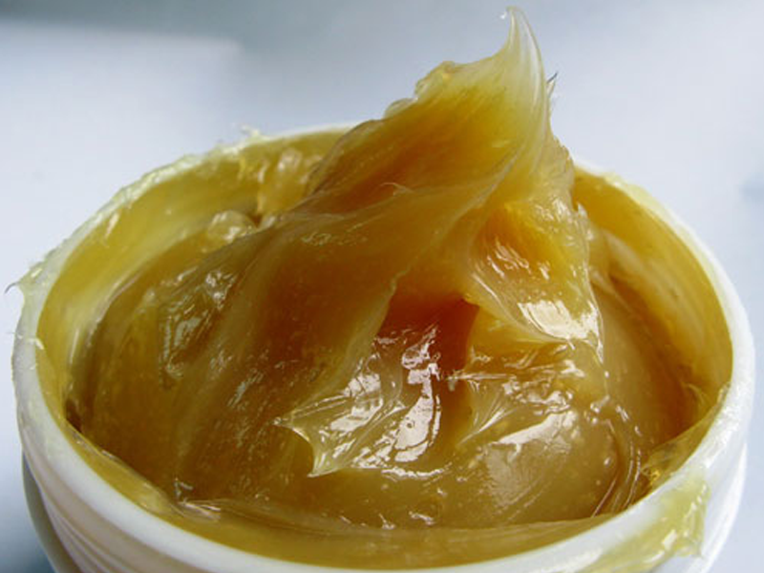
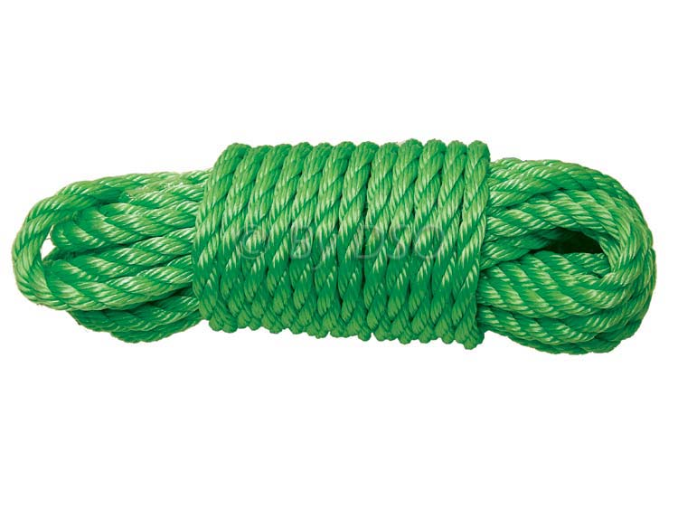
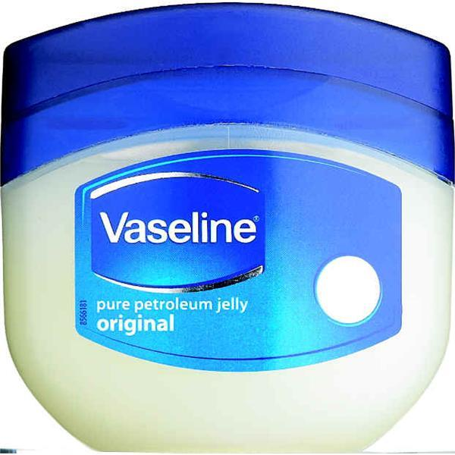
PROJECT - POLLUTION CATCHER

Slide 33
Permanent marker • Hole puncher • Magnifying glass • Scissors

Slide 34
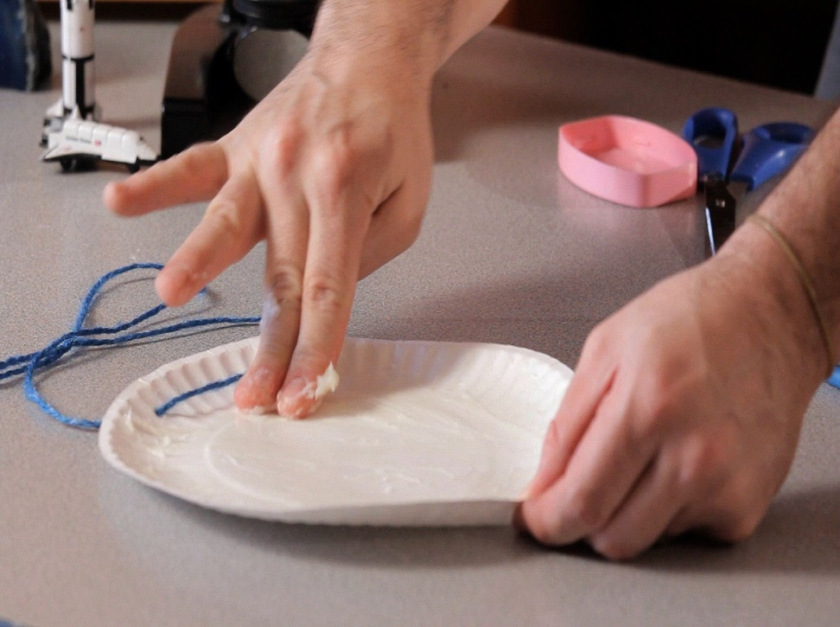
Find an area in which you can hang about six cut out pieces of the Bristol board.
Cut the Bristol board into six squares.
3. Draw a square with the permanent marker on each cut out piece of Bristol board,

Slide 35
raw a square with the permanent marker on each cut out piece
Apply vaseline or grease
In about a week, collect your squares.

Slide 36
Card Name | How Polluted?
Park
Backyard
Mall
School
Road
House

Slide 37
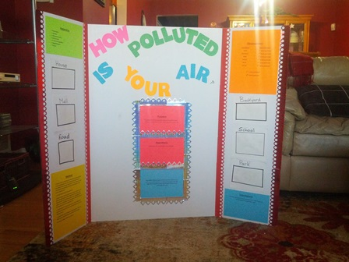

Slide 38
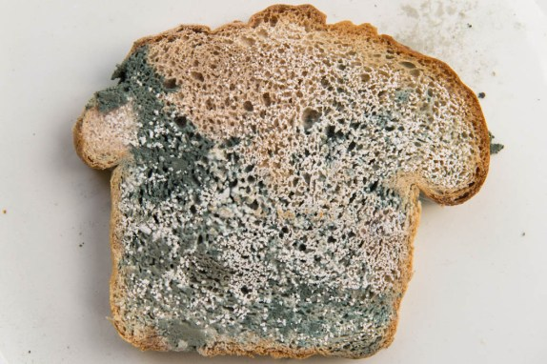
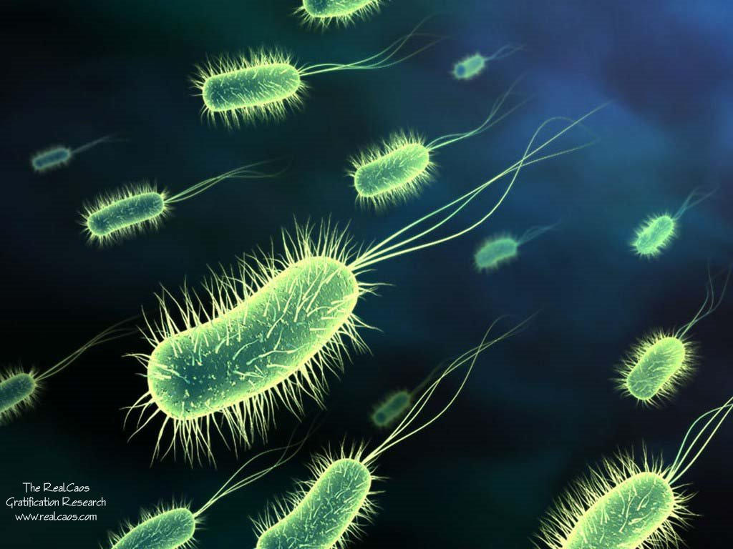
PROJECT IV

Slide 39
PROJECT IV

Slide 40
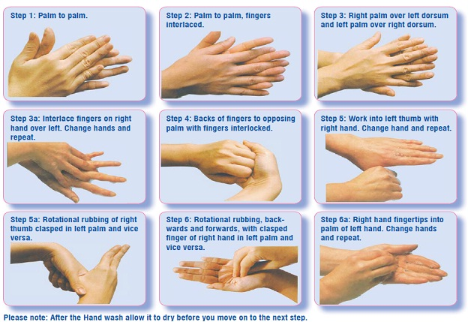
HAND WASH EXPERIMENT

Slide 41
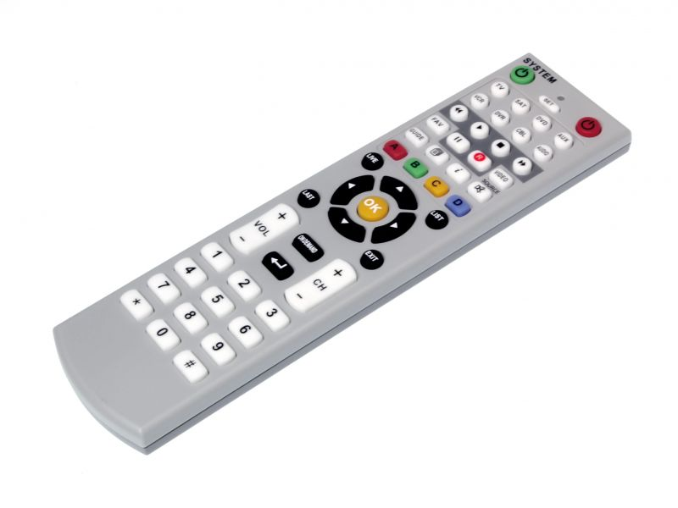
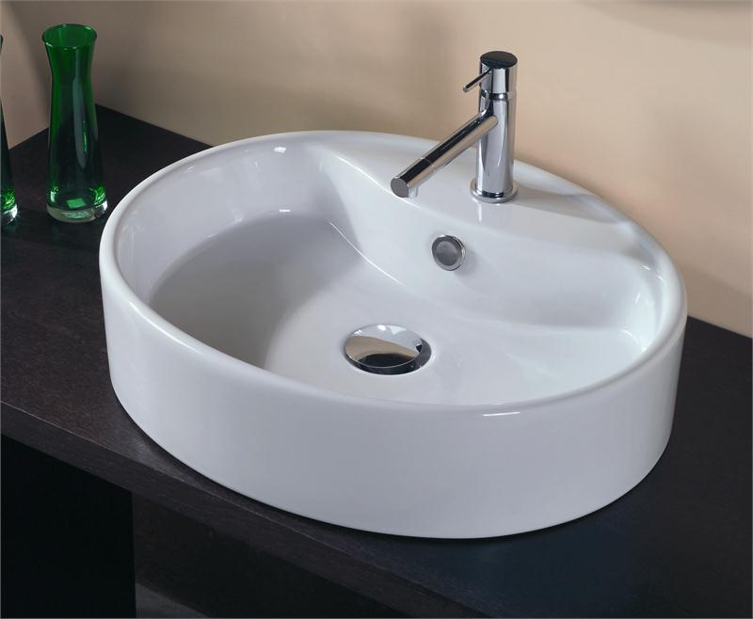
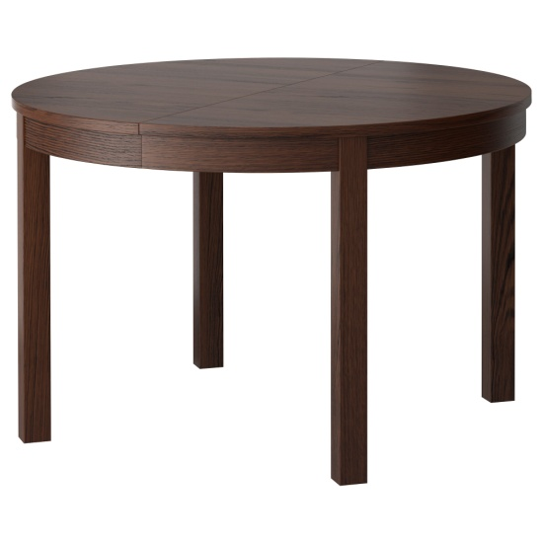
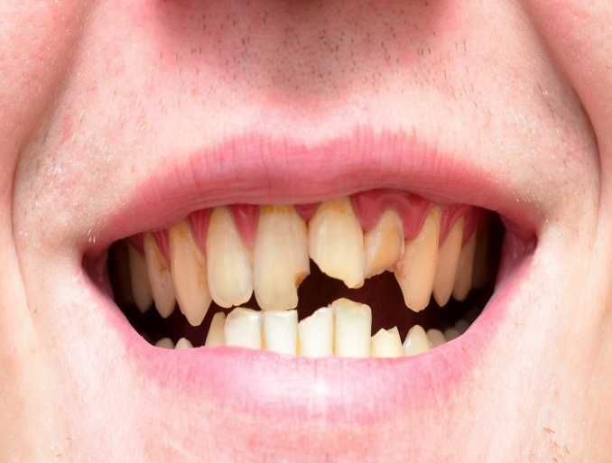

Slide 42
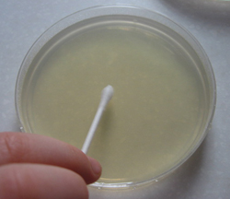
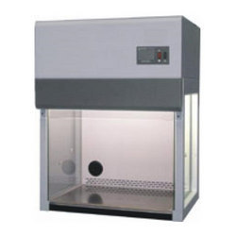
DIFFERENT SOURCES
MICROBIOLOGICAL EXPERIMENT
Petriplates
Agar medium
Sterile chamber
Private labs
Results will be provided
Compare the results

Slide 43
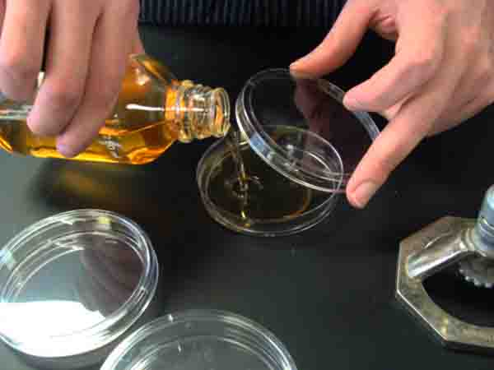
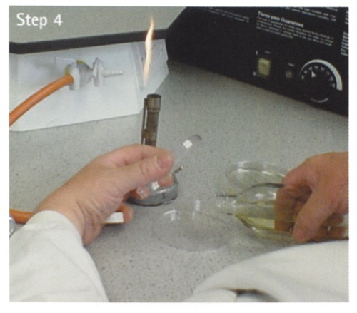
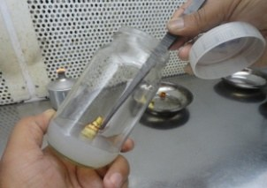

Slide 44
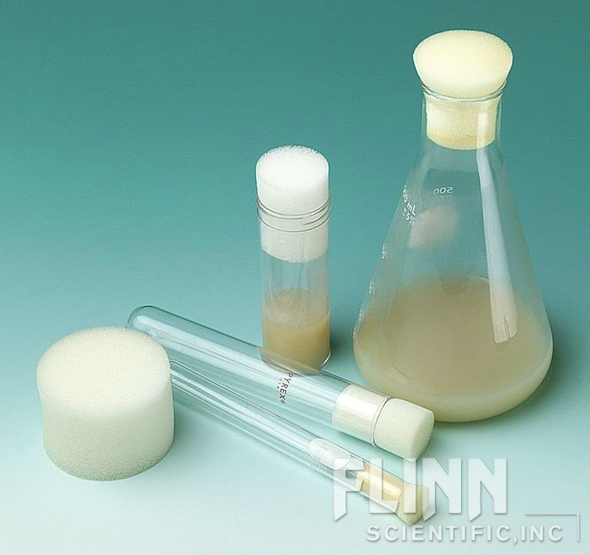
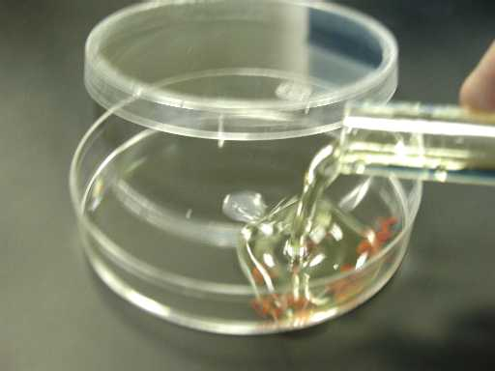
COMMERCIAL AGAR POWDER
ADD SUGAR
BOIL ( Pressure cooker)
BEFORE COOLING, POUR TO PETRIPLATE

Slide 46
AFTER THAT KEEP IT IN FRIDGE
SOURCE READY, TAKE THE PETRIPLATE
INOCULATE IT (before candle)

Slide 47
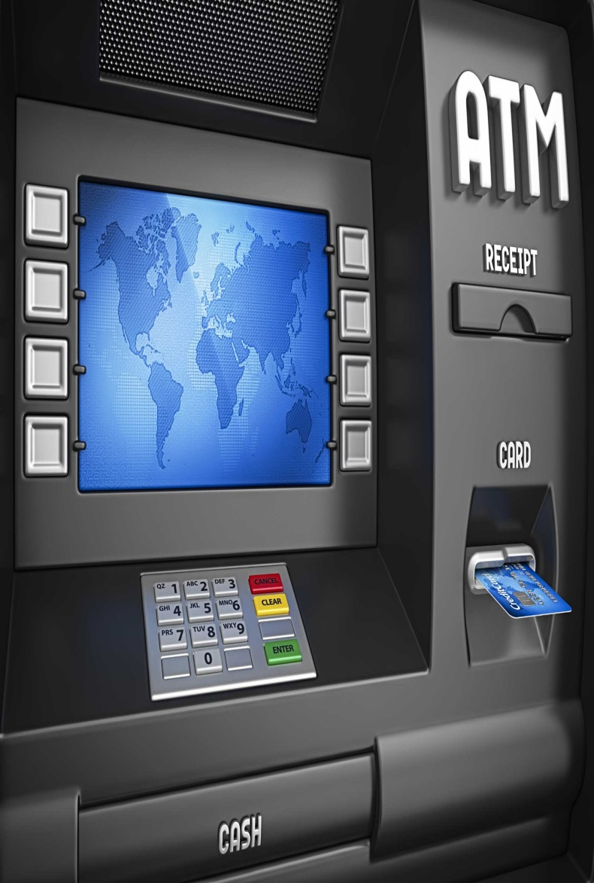
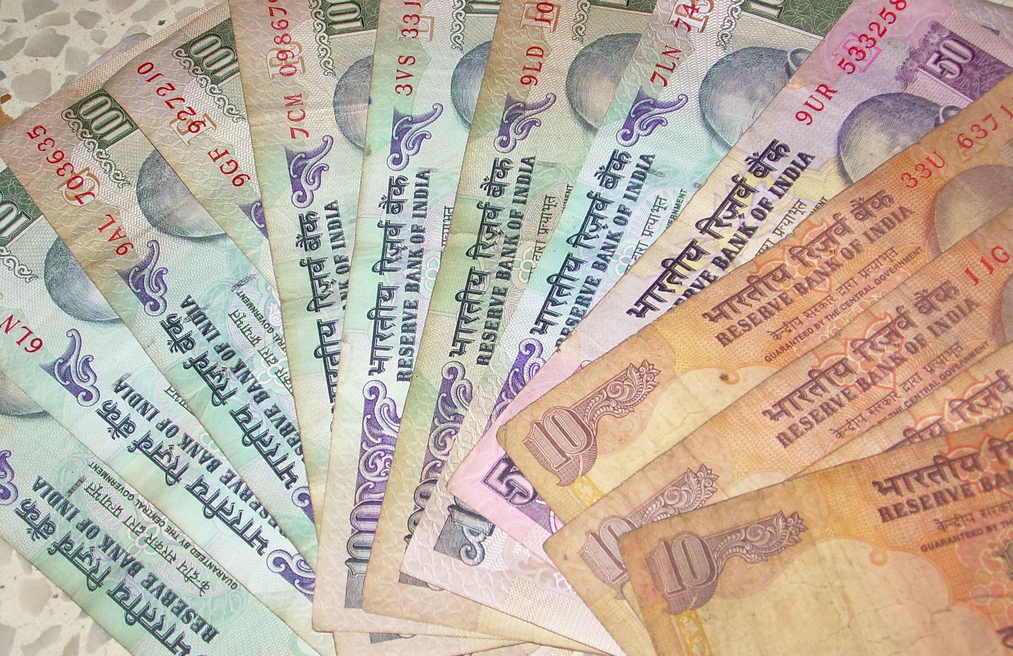
SOURCES

Slide 49
Handwash experiment - II
Same your repeating the experiment.
Your own fingers is the only source.
Main source is hand washing materials

Slide 51
handmade bar soap, -6-8 cups pure/filtered water -1 ounce dried leaf -1 ounce dried leaf –essential oils of

Slide 52
Grating your home made soap
Slightly heat the leaves
Boil to medium level
Add grated soap to the water
Stir till soap gets dissolved
Allow to cool
Add the desired plant oil.

Slide 54
PROJECT
Visit you nearest hospital
Take the datas of the patients with anemia
Analyze where they are coming from
Check their eating habits
Check the nutrition charts of the patients
Compare them with city hospital patients
Study their living patterns
Analyze who is vulnerable to this dangerous anemia
Steps you can take

Slide 56
PROJECT VI

Slide 57
PROJECT VI

Slide 58
PROJECT VI

Slide 61
greener” nail polish remover to those of an acetone-based remover.
biodegradable ingredients as well as ingredients
evaporate and pollute the atmosphere.
It also spreads awareness of the harsh chemicals that can be found in common household items.

Slide 62
D-limonene
Ethyl Acetate
Glycerin
Acetone Nail Polish Remover
Nail Polish
Ethanol
Oranges
Beakers
Hot Plates
Graduated Cylinders
Mason Jars
Hot Water Bath
Gloves, Goggles, Apron
Magic Bullet

Slide 63
T1 – glycerin 1ml = orange oil
T2 – glycerin 1 ml + D-limonene
T3 - glycerin 1 ml + ethyl acetate
2.5mL of glycerin, 15mL of d-limonene and 5mL of ethyl acetate.
_______of glycerin, _______ d-limonene and _______of ethyl acetate.
Apply separately to Plastic nails
Compare which is harsh and efficiency

Slide 64
Trial Number | Glycerin Concentration | Solvent Concentration | Effect on Nail Polish after 10 seconds of rubbing
1 | 2.5 mL | ---------- d-limonene
2 | 2.5 mL | ---------- ethyl acetate
3 | 2.5 mL | _______ orange oil
4 | 2.5 mL
5 | 2.5 mL
1 | 2.5 mL

Slide 65
Project

Slide 66
1. Empty out egg shells
2.Prepare tea
3.Boil water- temperature is consistent
4.Once tea has been prepared, - 1 emptied egg shell to each cup of tea.
5.Leave eggshells in tea
check on them in intervals to record data
(1 minute,
3 minutes,
5 minutes,
10 minutes,
15 minutes,
20 minutes,
30 minutes,
45 minutes).

Slide 68
Observation time intervals | Green tea | Black tea | White tea
1
3
5
10
15

Slide 69
PROJECT VII

Slide 72
NATURAL SUNSCREEN

Slide 73
PROJECT

Slide 74
Water
· Measuring cup
· 2 Medium disposable paper cups (8 oz)
· Food coloring (red, green, or blue)
· Measuring spoons
· Wooden craft stick
· 5 Small disposable paper cups (3 oz)
· Ballpoint pen
· 2 Cotton balls
· Sand (available at a hardware store)
· Quarter (25 cent coin)
· Metric ruler (15 cm)
· Scissors
· Activated charcoal (available at any pet store with the aquarium supplies)
· Fragrant oil (lemon or orange works best)

Slide 76
Other ideas
CELL PHONE RADIATION EMISSION

Slide 77
BICYCLING VS MOTORBIKE – CASE STUDY

