Slide 1
NCSC Seminar 2016-2017
Sub Theme
Life styles and livelihoods
M.Ramachandran M.Sc., M.Phil.,
Assistant Professor of Physics,
A.P.S.A.College,
Tiruppattur
9363070089
ramsapsac@gmail.com

Slide 2
Teaching is a very noble profession that shapes the character, calibre and future of an individual…youth have a dream and also they have a pain. The pain comes out of their dream; they want to live in a prosperous, happy and peaceful India.

Slide 3
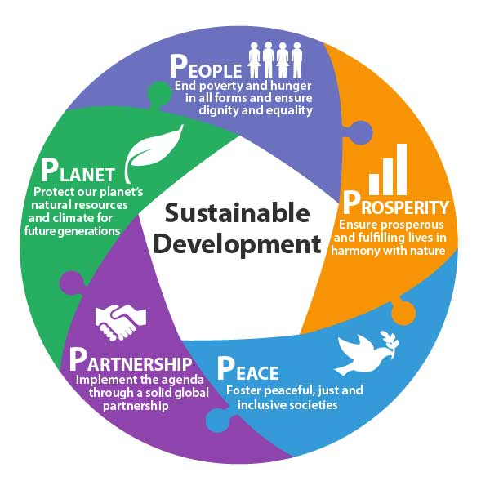
Economic development that is conducted without depletion of natural resources

Slide 4
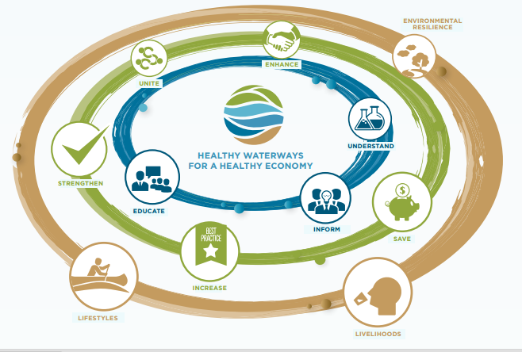
Sustainable development

Slide 5
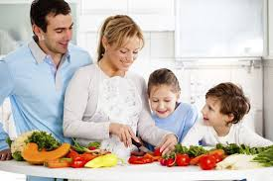
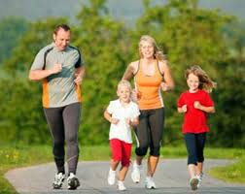
Introduction
lifestyles and livelihoods -healthy, livable and sustainable environment
Lifestyles define our identity-social position, political preferences and psychological aspirations.

Slide 6
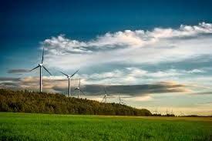
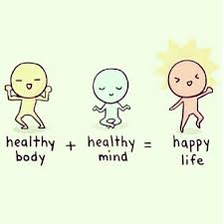
The changes in the patterns of livelihood and lifestyle - towards skills, sensitivity, habits, behavior, economy and culture

Slide 7
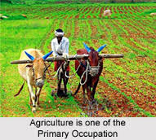
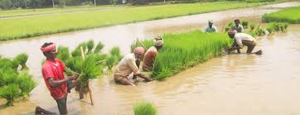
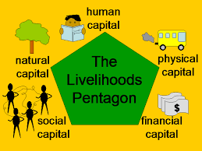
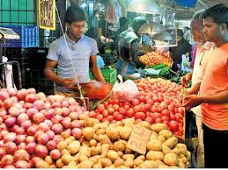
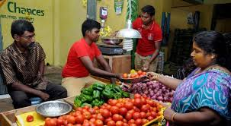
Livelihood -capabilities, assets and activities

Slide 8
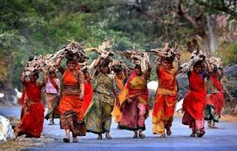
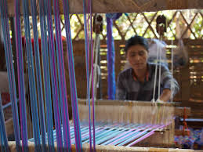
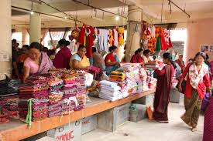
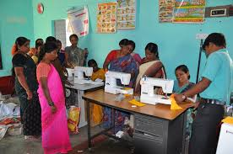
The effect of occupational, cultural and environmental changes
Lifestyles and livelihood -driven by certain crucial factors

Slide 9
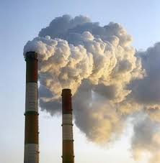
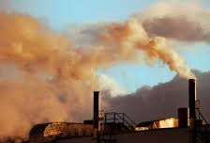
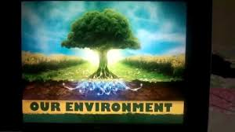
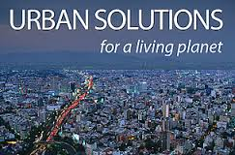
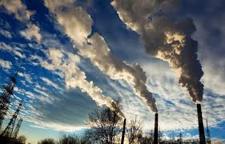
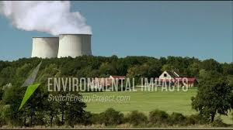
Focus on the negative impacts -positive impacts on lifestyle and livelihood.

Slide 10
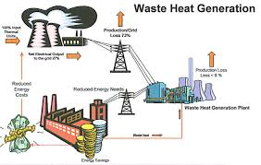
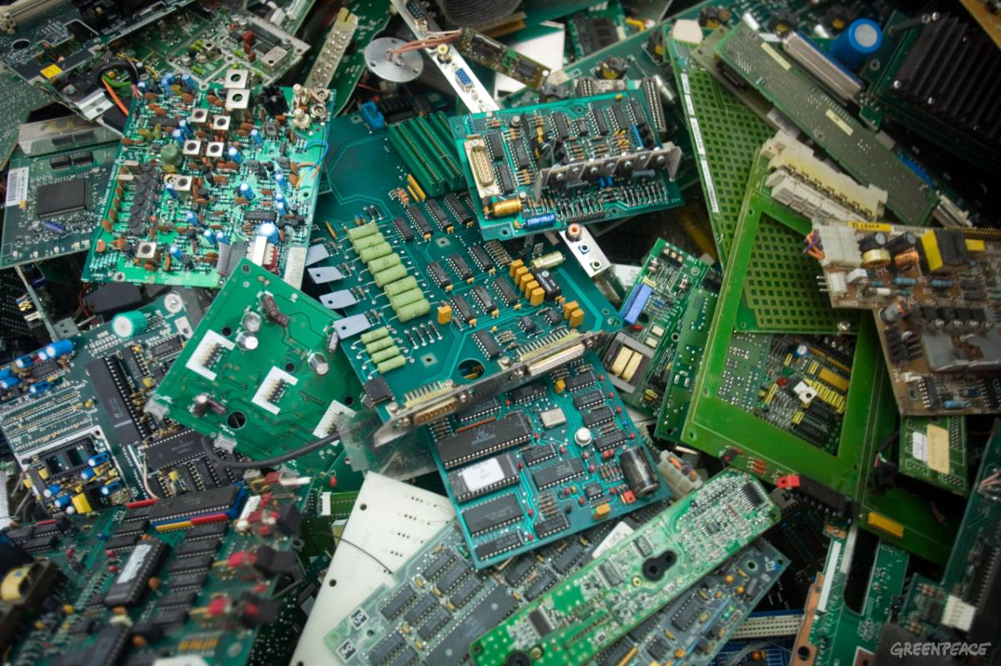
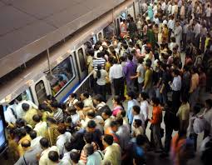
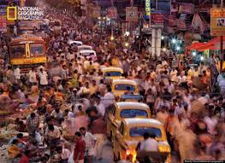

Slide 11
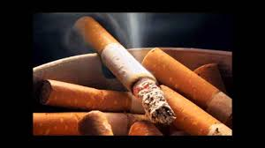
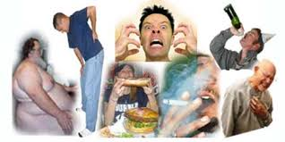
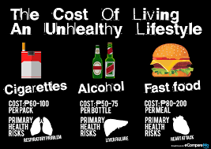
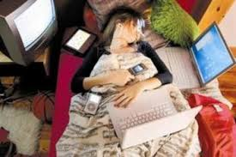
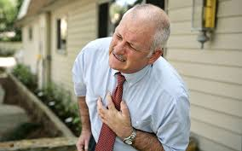
Unsustainable activities and interventions - accelerated the problems

Slide 12
Solution?

Slide 13
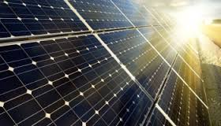
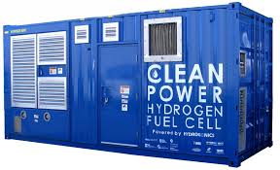
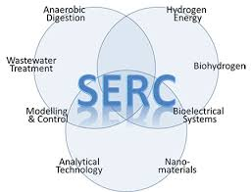
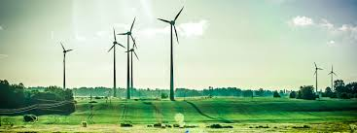
science, technology and Innovation for Sustainable Lifestyles and Livelihoods -product, process, system, ideas

Slide 15
waste generation, its handling and management,
PROJECT-1

Slide 16
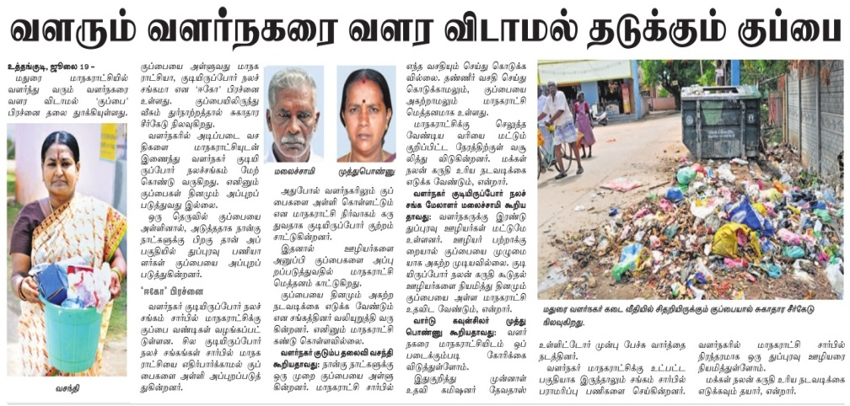
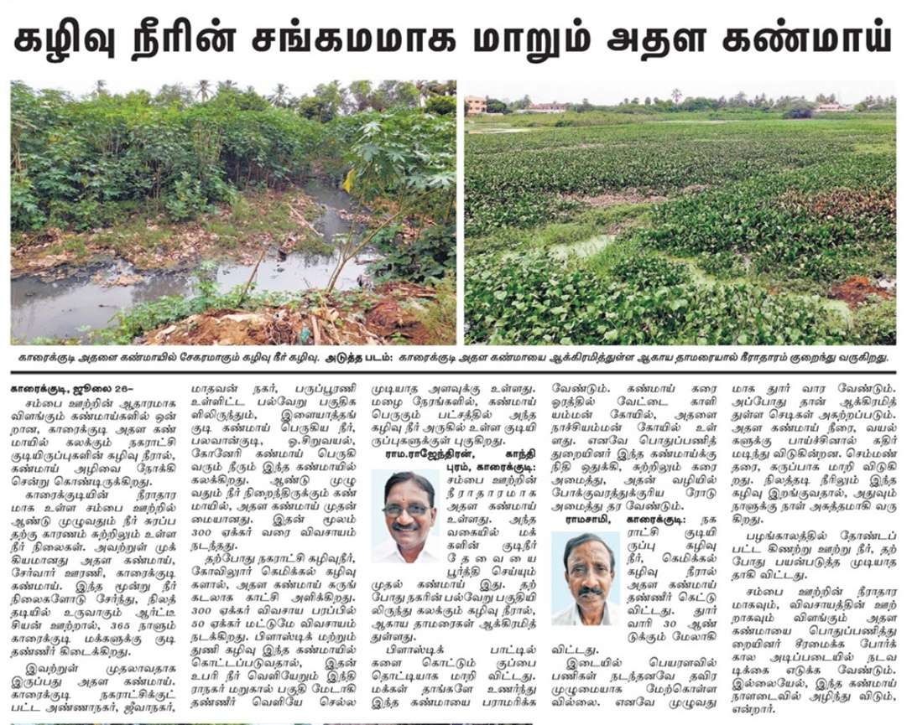

Slide 17
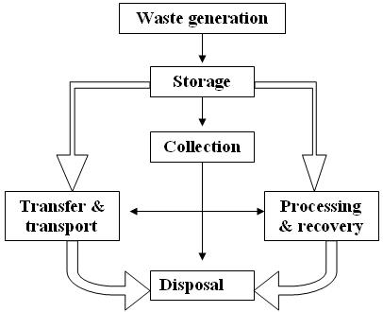
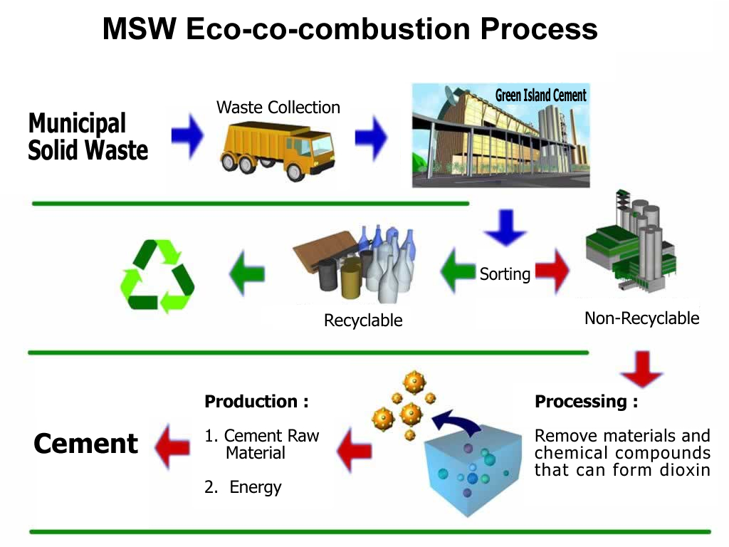
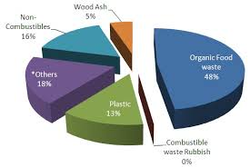
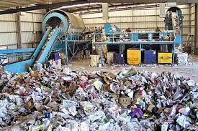

Slide 18
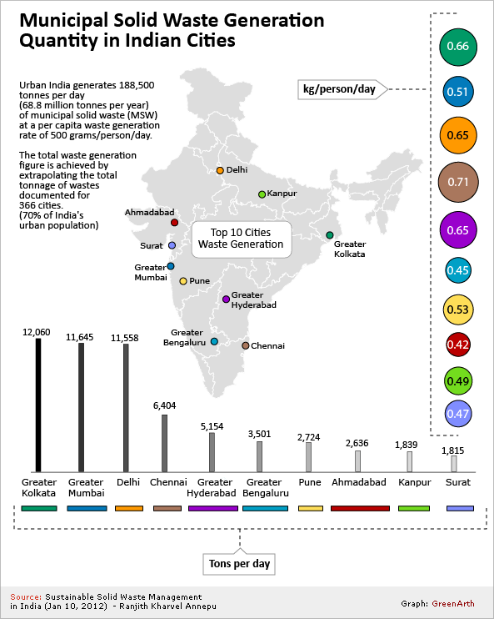
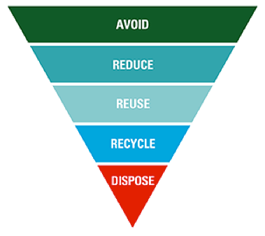
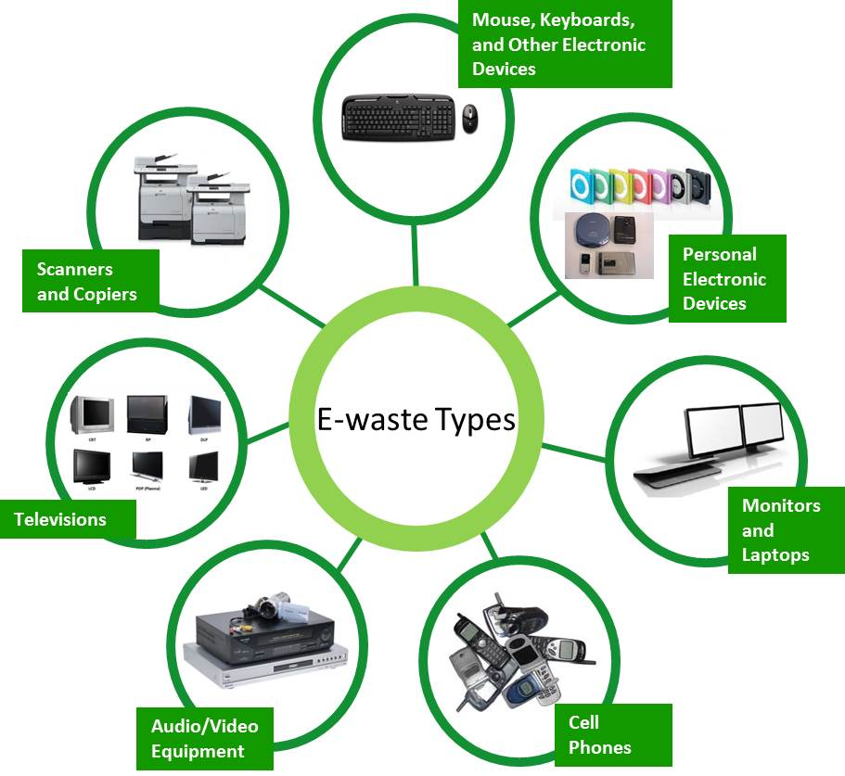

Slide 19
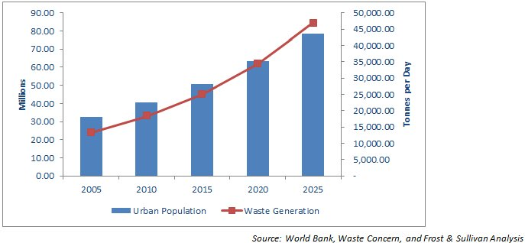
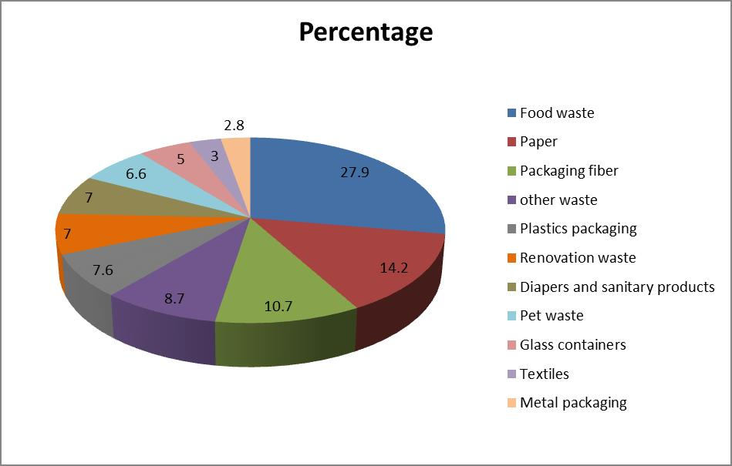
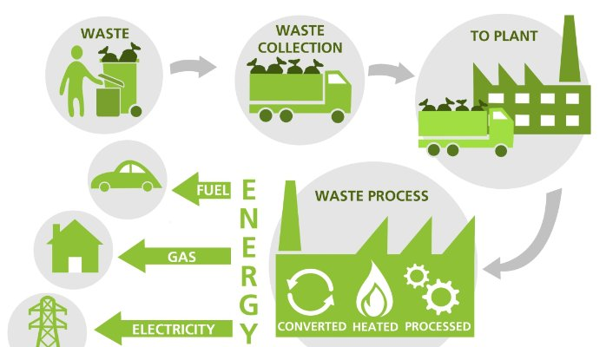

Slide 20
Some ideas
Effect on Mushroom growth in different vessels like Plastic pot and Polyethylene cover.
Experiment:
Monitor four weeks.
supply Cow dung to both samples
Do the mineral test
Result and conclusion

Slide 21
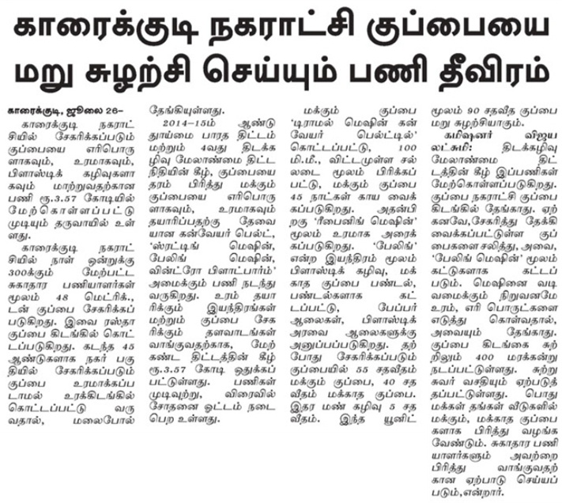

Slide 22
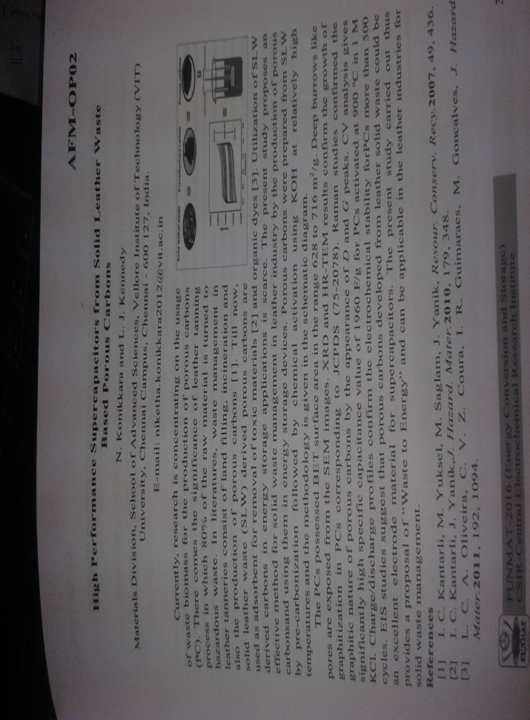
Recent Research articles

Slide 23
PROJECT-2
Mapping of changes in community lifestyle and livelihood of a village in comparison to an urban area

Slide 24
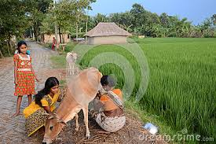
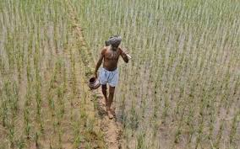
poverty is not only a product of material deprivation
physical weakness, social isolation, vulnerability and powerlessness

Slide 27
Case studies on rural and urban poor people
Data sheet contains
Economic activities
Expenditure and purchasing pattern
Shelter and Environmental services
Using social services
Rural –Urban Ties
Social network
Community participation

Slide 28
Effect on nano particle in crop growth-scientific approach
Take any seed –e.g Green pea
Cultivate in sample soil
MgO (bare,3,6,9,12) wt% added to the water and feed.
After Four weeks, You analyze the plant extract to take FTIR (Fourier Transform Infrared Spectroscope).
Based on this result you optimize the
Feeding MgO ratio.
Result and discussion.
Identify the deficiency using
frequency spectrum .

Slide 29
PROJECT-3
study on food and energy consumption pattern in different areas

Slide 34
Some ideas
Select the different food pattern-
Type of oil used: HDL, LDL value
Survey the health problem and food habit.
Select Accessory items used –medicinal value chart.
Stone formation- food habit
positive food habit -Adverse food habit

Slide 35
PROJECT-4
Measuring carbon footprint in your own area and its comparison with the impact of handprint,

Slide 38
Carbon-dioxide emissions are expected to increase from 29 gigatonnes per year to 43 Gt yr⁻¹ or 36 Gt yr⁻¹

Slide 40
Virtually all human activities cause the CO₂ emissions that
lead to climate change.

Slide 45
PROJECT-5
Analytical study on the positive and negative effect of communication technologies and social media on community and culture

Slide 46
Numerous causal relationship formed through social media
Fastest communication available to mankind
Social media and digital technologies have a huge influences on a student’s education

Slide 47
Victims have been drive to suicide
Adults, kids are more vulnerable to cyber bullying.

Slide 50
Effect of communication technology and social media on community and culture.
Data collection- Cell phone, internet, online services, Fb, WhatsApp, Linked in, Twitter etc.,
Analyze- advantage and disadvantages and draw the graph and chart.
Report writing.
Survey on Traditional games and cell phone games
Conclusion

Slide 52
PROJECT-6
Mapping of case studies of sustainable livelihood systems, study and analysis on occupational mobility and migration

Slide 55
Some ideas
Data collection:
50 members –foreign countries
Family status, Assets, Relationship between the members, emotional losses.
Analyze and draw the chart and graph
Conclusion.

Slide 57
Thanks for your kind Attention

