Slide 1
NATIONAL CHILDREN’S SCIENCE CONGRESS 2015-2016
Sub Theme- VII
Traditional Knowledge Systems
Presented by
Dr. J. Arockia John Paul
Asst. Prof. of Zoology
APSA College

Slide 2
Traditional Knowledge Systems (TKS)
Traditional knowledge refers to the knowledge, innovations and practices of indigenous and local communities around the world. Developed from experience gained over the centuries and adapted to the local culture and environment.
Traditional knowledge is transmitted from generation to generation orally.
It tends to be collectively owned and takes the form of stories, songs, folklore, proverbs, cultural values, beliefs, rituals, community laws, local language, and agricultural practices, including the development of plant species and animal breeds.

Slide 3
What is Traditional Knowledge?
Medicinal, Agricultural
& Ecological Knowledge
Music & Dance,
Stories & Poetry
Artesanat
(Handicrafts)
Spiritual Expression
Transmitted orally across generations
Collective responsibility & ownership
Constantly evolving

Slide 4
It is a practical nature which have real life applications developed over time, particularly in such fields as agriculture, fisheries, health, horticulture, forestry and environmental management
Some of their practices have been proven to enhance and promote biodiversity at the local level and aid in maintaining healthy ecosystems.
Modern industry and agriculture as well including plant-based medicines, health products and cosmetics
Products include agricultural and non-wood forest products as well as handicraft.
They have cultivated and used biological diversity in a sustainable way for thousands of years.
Their skills and techniques provide valuable information to the global community and a useful model for biodiversity policies.

Slide 5
THE ROLE OF TRADITIONAL KNOWLEDGE IN HEALTHCARE AND AGRICULTURE
-TRADITIONAL MEDICINE: ITS IMPORTANCE AND PROTECTION
  -The important role of traditional medicine in human health care
  -Challenges involved in protecting knowledge of traditional medicine
  The gaps between traditional medicine areas and existing modern Patent Law
  -Requirements and constraints involved in using traditional medicine
  Inadequate awareness • Insufficient investment in research and development • Inappropriate distribution chains

Slide 6
THE USE AND COMMERCIALIZATION OF GENETIC RESOURCES AND TRADITIONAL KNOWLEDGE IN THE CASE OF CROP AND MEDICINAL PLANTS
-The case of crop plants and varieties and traditional knowledge
-Legislative instruments on genetic resources and TK
THE ROLE OF TRADITIONAL HEALERS IN PREVENTION STRATEGIES AND TREATMENT OPTIONS
USING FARMERS’ TRADITIONAL KNOWLEDGE TO CONSERVE AND PROTECT BIODIVERSITY:
-world centre of crop biodiversity and associated traditional knowledge
-Seeds of survival programme
-conservation and enhancement of native seed stock (land race), and maintenance of a selection of indigenous land races (elite materials) in identified farms.

Slide 7
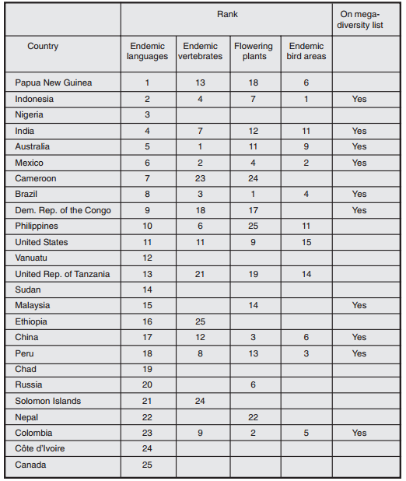
Endemism in Language compared with rankings in Biodiversity

Slide 8
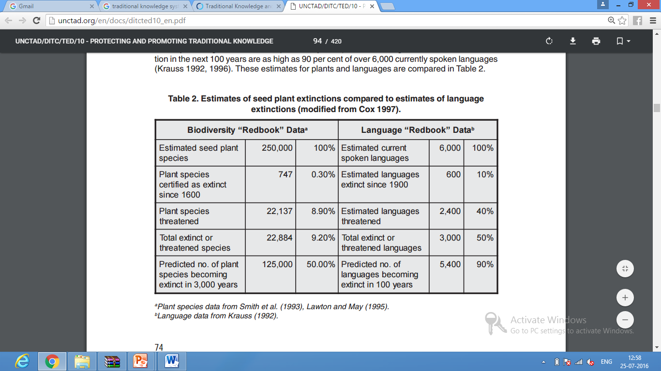
Estimates of seed plant extinctions compared to estimates of language extinctions

Slide 9
Knowledge on spiritual conservation
Knowledge on medicinal plants-ethnobotany and treatment
Knowledge on building
Knowledge on tools and techniques for hunting
Knowledge on weather prediction
Knowledge on food and water storage
Knowledge on NTFP
Knowledge on agricultural practices
Knowledge on celestial navigation
Knowledge on ethnoastronomy
Knowledge on harvesting
Knowledge on proverb
Knowledge on land utilization and crop rotation

Slide 10
Ideas for projects
Knowledge on spiritual conservation
Festival during summer
Turmeric water spray & tie neem twigs
Cowdung coating and spraying over floor
Playing Udukkai
Thulasi madam
Yagam for rain
Sprout in a pot
Recording and analysis of spiritual activities in a scientific manner

Slide 11
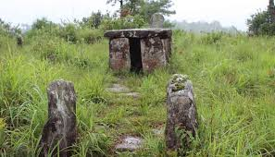
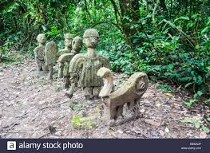
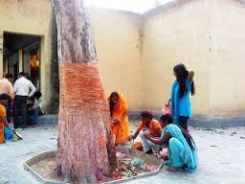
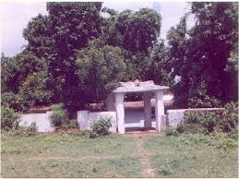
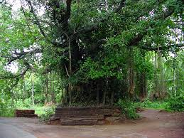
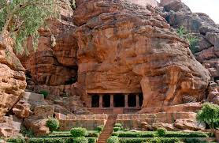
Sacred groove

Slide 12
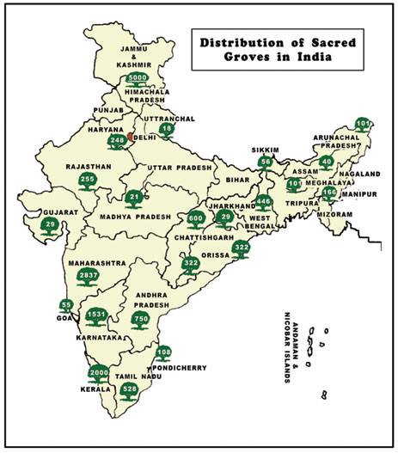
Conduct a survey on sacred grooves in our area and the list of medicinal plants protected and endemic diseases

Slide 13
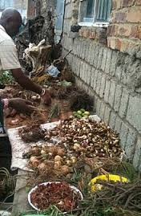
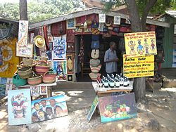
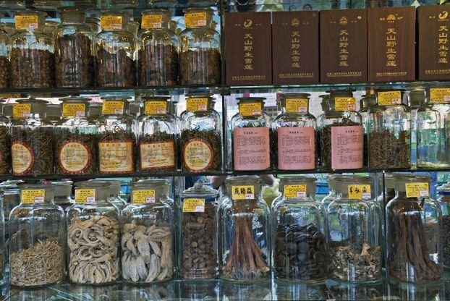
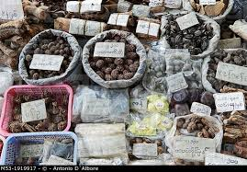
Knowledge on medicinal plants-ethnobotany and treatment

Slide 14
These combine in certain ways to give the three bodily humours, called muppini in modern Tamil. They are said to be in the proportion of 1 wind to ½ bile to ¼ phlegm, which is opposite to that found in Ayurveda:
Wind (Tamil: vatham, Sanskrit: vata) is a combination of space and wind, and is responsible for nervous actions, movement, activity, sensations, etc. It is found in the form of the five bodily winds.
Bile (Tamil: pittam, Sanskrit: pitta) is made up of fire alone and takes care of metabolism, digestion, assimilation, warmth, etc. Its principal seat is in the alimentary canal from the cardiac region to small intestines. Some Ayurvedic formulations state that bile is a combination of the elements fire and water.
Phlegm (Tamil: siletuman, Sanskrit: shleshman, kapha) is a combination of earth and water and is responsible for stability in the body. Its principal seats are in the chest, throat, head, and joints.

Slide 15
Diagnosis in Siddha medicine
The diagnosis of disease in Siddha medicine relies on the examination of eight anatomical features (envagi thaervu), which are evaluated in terms of the three humours:
The tongue: black indicates wind, yellow or red bile, and white phlegm; an ulcerated tongue points to anaemia;
The complexion: dark indicates wind, yellow or red bile, and pale phlegm;
The voice: normal indicates wind, high pitched bile, and low pitched phlegm;
The eyes: muddy coloured indicates wind, yellowish or red bile, and pale phlegm;
The touch: dryness indicates wind, warmness bile, and cold, clammy phlegm;
The stool: black indicates wind, yellow bile, and pale phlegm;
The pulse -The index finger feels the windy humour, which should have the movement of a swan, a cock, or a peacock; the middle finger feels the bilious humour, which should have the movement of a tortoise or a leach; and ring finger feels the phlegmatic humour, which should have the movement of a frog or a snake.
The urine- reading the distribution of a drop of gingili (sesame) oil added to the urine. longitudinal dispersal indicates windy humour; dispersal in a ring, bilious humour; and lack of dispersal points to phlegmatic humour.
Diagnosis of pregnancy and determination of foetus sex

Slide 16
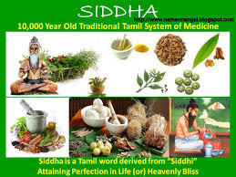
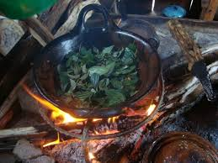
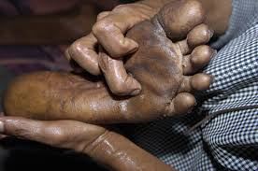
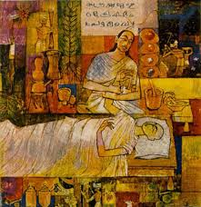
Document the treatment methods of tripes, herbal vendors and elders

Slide 17
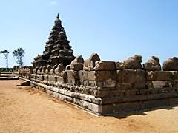
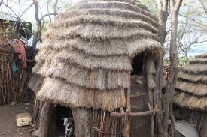
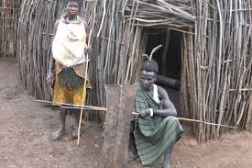
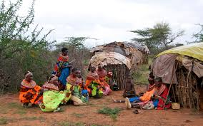
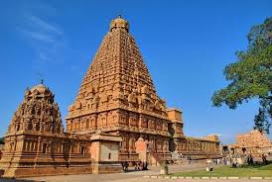
Knowledge on building
Record the significance of chetinad buildings, Temples and water outlets

Slide 18
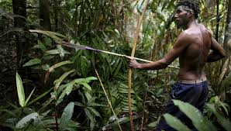
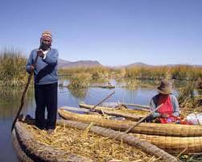
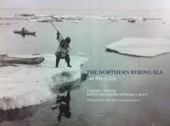
Knowledge on tools and techniques for hunting
Honey collection methods, Fishing methods (leaves), Leaf for nerve stimulation, water plant

Slide 19
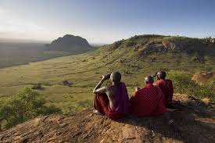
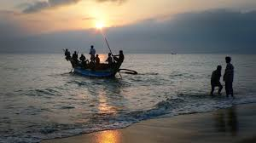
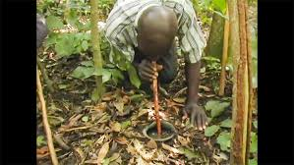
Knowledge on weather prediction
In Kenya- Nganyi Indigenous Knowledge Adaptation Project

Slide 20
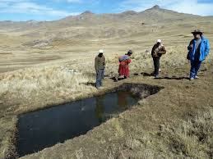
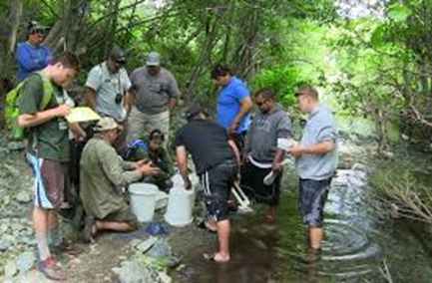
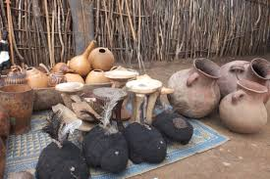
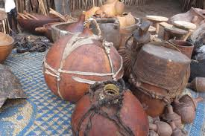
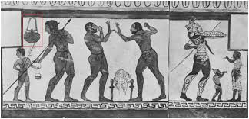
Knowledge on food and water storage
Storage of butter
Salt preservation ;
Fermented food,
Water tank

Slide 21
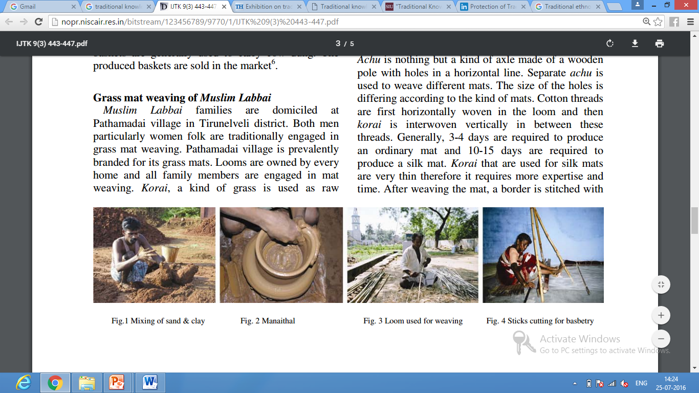
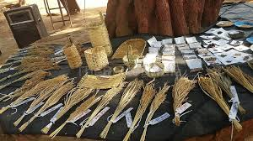
Handicrafts
Knowledge on NTFP
Preparation of Handicrafts and NTFP and their use

Slide 22
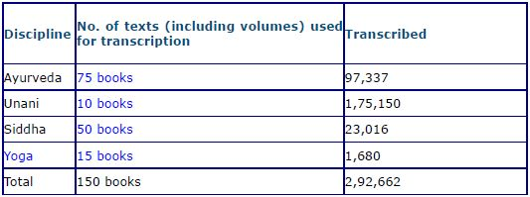
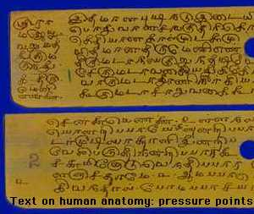
Current status of transcription of the traditional medicine formulation in the Traditional knowledge Digital Library
Knowledge through Tamil Literature

Slide 23
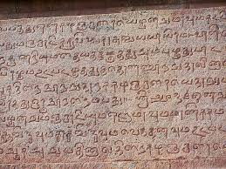
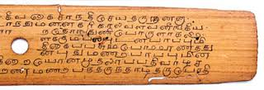
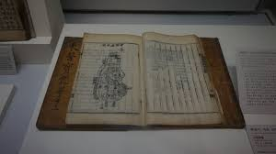
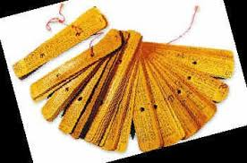

Slide 24
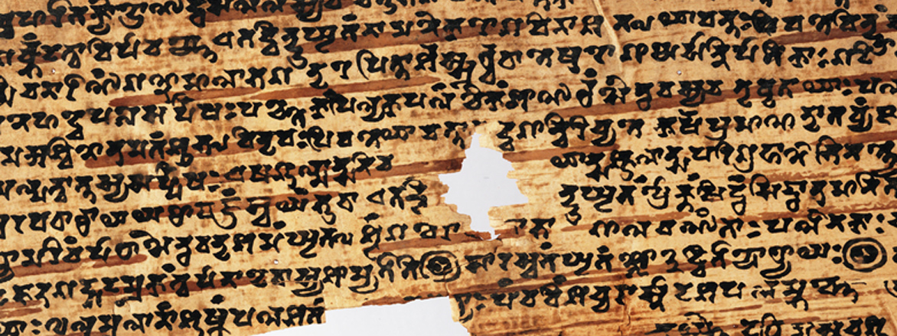
The poor, those suffereing from disease and those afflicted by sorrow should be helped. Even insects and ants should be treated with compassion, just as one's own self.
(Ashtangahrdayam Sutrasthanam 2.23)
The Bower Manuscript, 4-6 CE Discovered in Central Asia (Bodleian Library, Oxford University)
Document the medicinal uses, construction methods, agricultural practices from Tamil literature and proverbs

Slide 25
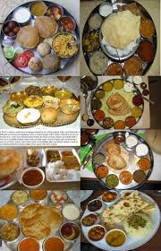
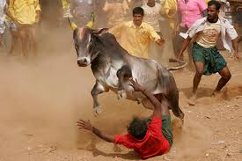
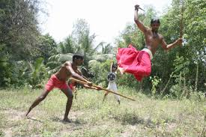
Traditional foods and games
Collect the importance of traditional foods and games for better livelihood

Slide 26
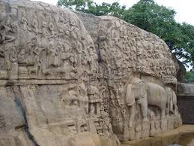
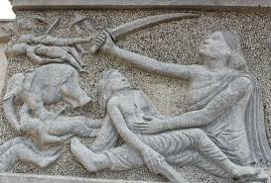
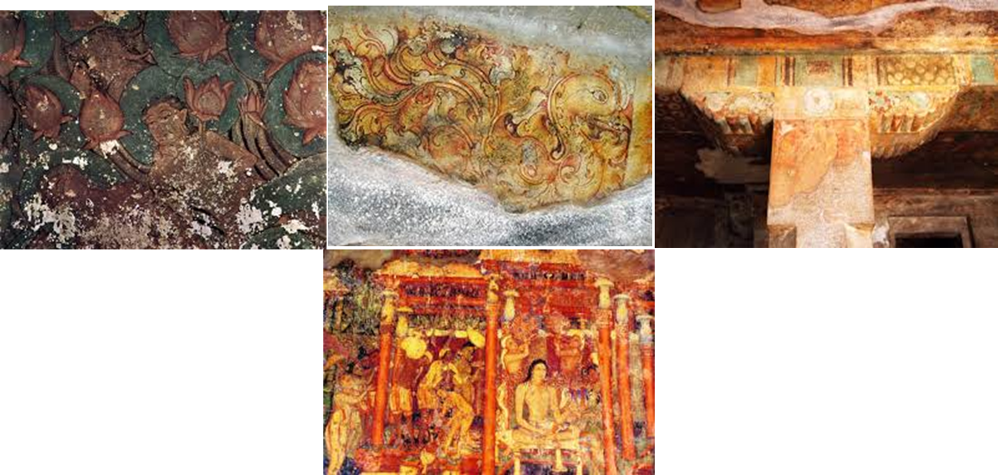
Knowledge through sculptures
Knowledge on paintings

