Slide 1
NCSC 2016 Focal Theme Science, Technology and Innovation for Sustainable Development
Heartily Welcome to all
State Level Orientation Workshop

Slide 2
I am
Prof.C.Govindasamy
Department of Oceanography and Coastal Area Studies
School of Marine Sciences
Alagappa University
Thondi Campus – 62 409
Email: drcgsamy@gmail.com

Slide 3
In Biological System,

Slide 4
that, species is more powerful and very dangerous species
in the world.

Slide 5
Genus: Homo
Species: H. sapiens

Slide 6
A Teacher Formula
out let Teaching Inlet learning
Teacher Students Knowledge

Slide 7
Light CO₂
2. Primary Teacher High School Teacher
H₂O Nutrients
College Teacher University Teacher as a
well growth Plants (Student)

Slide 8
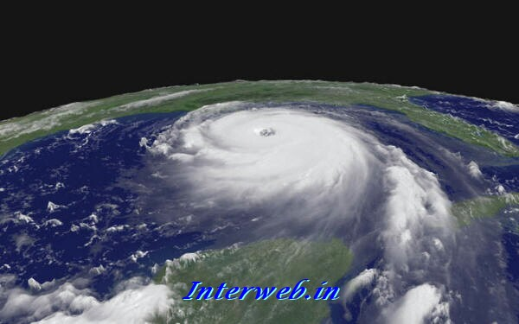
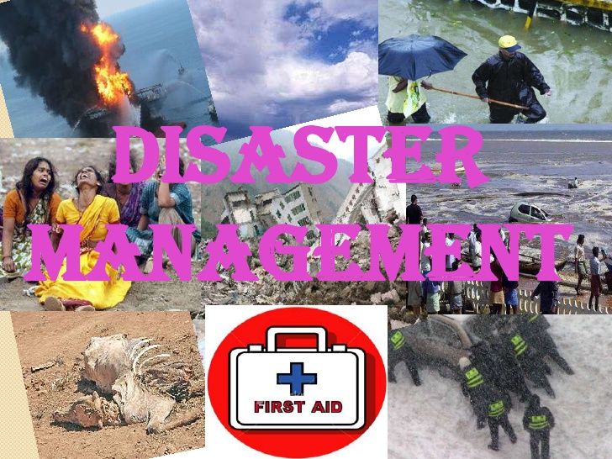
Theme 6

Slide 9
Subject Theme 6: Disaster Management
Last 2 decades : Losses due to disasters are increasing in terms of sophistication and civilization of our life style of the world.
Disasters apart, factors that enhance the gravity and severity of disasters include:
density and size of population,
unplanned urbanization,
environmental degradation,
local and global impacts of climate change
global warming and ozone depletion etc.
bad governance / short-sighted planning / Lack of disaster preparedness.
All of above are just manifestations of
UN-SUSTAINABLE PATHWAYS

Slide 10
Definitions
Dictionary meaning of "disaster" may be taken as: "a sudden accident or natural event that causes great damage or loss of life“. The biggest problem with the disasters is the suddenness and swiftness with which they arrive.
Earthquakes, industrial accidents, oil-spills, forest-fires, terrorist activities etc. are some of the more commonly encountered disasters
Disaster management Act –NDMA- National Disaster Management Authority, Govt. of India, 2005)

Slide 11
Natural Types of Disasters
Natural Types of Disasters
-
Agricultural diseases & pests Damaging Winds Drought and water shortage Earthquakes Emergency diseases (pandemic influenza) Extreme heat Floods and flash floods Hail | Hurricanes and tropical storms Landslides & debris flow Thunderstorms and lighting Tornadoes Tsunamis Wildfire Winter and ice storms Sinkholes

Slide 12
What is the most common natural disaster in the world?
Both earthquakes and tornadoes strike suddenly without warning. Flooding is the most common of natural hazards, and requires an understanding of the natural systems of our environment.
What is a natural hazard?
Natural hazards are severe and extreme weather and climate events that occur naturally in all parts of the world, although some regions are more vulnerable to certain hazards than others. Natural hazards become natural disasters when people's lives and livelihoods are destroyed.

Slide 13
In the last 20 years, flooding has been the most common natural disaster by far, accounting for 43% of all recorded events. In a joint with the UN Office for Disaster Risk Reduction, the Centre for Research on the Epidemiology of Disasters recorded 3,062 natural flood disasters between 1995 and 2015. The following infographic from the report highlights the most frequently occurring natural disasters between 1995 and 2015.

Slide 14
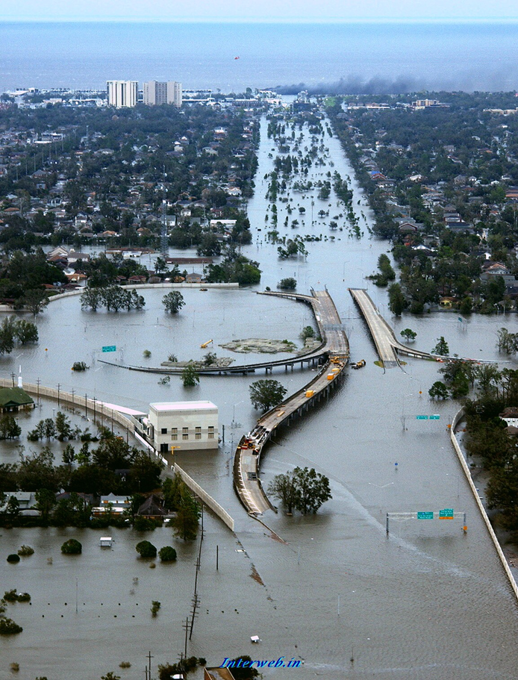
Which natural disasters hit most frequently?

Slide 15
Man-Made and Technological Types of Disasters
Hazardous materials Power service disruption and blackout Nuclear power plant and nuclear blast Radiological emergencies | Chemicalthreat and biological weapons Cyber attacks Explosion Civil unrest

Slide 16
What is a man made disaster?
A man-made disaster results from man-made hazards (threats having an element of human intent, negligence or error, or involving a failure of a man-made system). They differ from natural disasters that result from natural hazar.
What is a natural calamity?
A natural disaster is a major adverse event resulting from natural processes of the Earth; examples include floods, volcanic eruptions, earthquakes, tsunamis, and other geologic processes

Slide 17
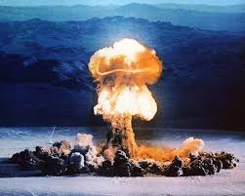
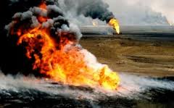
Man-Made :Nuclear Power Plant Explosion
London's Killer Fog. ...
The Al-Mishraq Fire. ...
The Nuclear Power Plant Explosion in Chernobyl, Russia. ...
The Kuwait Oil Fires. ...
The Destruction of the Aral Sea. ...
The Exxon Valdez Oil Spill. ...
Dioxin Pollution. ...
Hiroshima Nuclear (atomic) Bomb - USA attack on Japan (1945)

Slide 18
General and scientific Types of Disaster
Hydrological and Meteorological Disasters
Geological Disasters
Biological Disasters
Nuclear & Industrial Disaster
Accidental Disaster

Slide 19
2. Geological Disasters (6 Types):-
Landslides,
Mud flows
Earthquake,
Mines fires
Dam failure and
General fire.

Slide 20
3. Biological Disasters (4 Types) .
Epidemics
Pest attacks
Cattle epidemics and
Food poisoning.

Slide 21
4. Nuclear & Industrial Disaster (3 Types)
Chemical
Industrial and
Nuclear accidents.

Slide 22
5. Accidental Disaster (7 Types)
Urban and forest fire,
Oil spill
Mine flooding incidents
Collapse of huge building structure
Bomb blast
Air, road and rail mishaps
Boat capsizing and Stampede during large congregations.

Slide 23
Based on above said facts…..
We aware about this aspects….
The Management practices to be establish
So, we know some forthcoming basic Ideas…..

Slide 24
New Project Ideas
Identification of potential disaster
Sites Selection
Proper locations
Vulnerable target groups and population
Developing a action plan - involving local community and authorities
Creating awareness by organising mock exercises using locally available recourses .

Slide 25
Cont…
Mapping/disaster management for your local area.
Awareness creation, development of education material and creation of awareness, preparing volunteers and developing opportunities for leadership.
Preparing students with basic lesson in tacking a fire outbreak, accident in a chemical laboratory, flood or even a bomb threat and terrorists attack and hostage crisis.

Slide 26
Tips to Remember
Make sure that your plan is cost effective, innovative and sustainable.
Make optimum use of locally available resources rather than depending on the external agencies for help and support.
Suggest a mechanism how the risk reduced is measurable.
Involve villagers/community members to assess the local resources and drawing the map and plan.
Notes:
Make sure that your plan is cost effective, innovative and sustainable.
Make optimum use of locally available resources rather than depending on the external agencies for help and support.
Assess the existing capacities/resources (both externally/within community) that can assist in risk reduction to provide an element of novelty in your planning.
Suggest a mechanism how the risk reduced is measurable.
Involve villagers/community members to assess the local resources and drawing

Slide 27
Developing community/school plan to tackle disasters and emergencies by risk assessment, hazards, vulnerabilities and contingency planning to bring back life to normalcy in shortest period of time.
Study and developing a strategy for mitigating structural/material deficiencies prone to disaster like earthquake, fire, flood etc. through retrofitting or during on-going re-modeling in your locality, housing society and village.
Chemical hazard identification and risk analysis including awareness about basic information about the resources, demography, existing organizational set up, administrative facilities at the state, district and local levels.
Describes preparedness and mitigation measures as well as response mechanisms.
Cont …

Slide 28
Develop a disaster specific preparedness plan keeping in view the demography/topography and the disaster profile of your area.
Identification of hazard and risk analysis of your area by incorporating basic information about the resources, demography, existing organizational set up, administrative facilities at the state, district and local levels by developing a workable mechanism for preparedness and mitigation measures along with a response mechanisms.
Finally, Individually

Slide 29
Other Tips
Develop a Release plan for persons with special needs (like physically/visually disabled population and senior citizens) in relation to a particular disasters or emergencies (fire, flood, earthquake, etc.) The project must have following components:-
Consultation with persons with special needs for resources needed during disasters/emergencies.
Identification of basic amenities (water sanitation etc.) required by them during/after the disaster takes place.
Existing schemes and institutes providing assistance devices.
Identification and listing of people/govt and non-govt institutes/agencies of the people who can provide the help to people of special needs.
Preparing the inventories of items required for rescue and relief operation.
Develop alternate communication channels which will work in any disasters (grid independent, one to one communication systems like mesh networks etc.)
method of construction.

Slide 30
Study the impact of disaster on the livelihood of affected population in recent past.
Develop a mechanism (including mathematical modeling) to estimate the loss of livelihood or environmental degradation in a hypothetical disaster situation of your area/ region or State.
Estimate the economic loss by collecting primary and secondary data in relation to Environmental Degradation / loss of livelihood in your area and propose a plan to reduce the same in relation to a particular disaster (flood, cyclone, earthquake, sea level rise, tsunami)
Study the local and traditional consideration, taken into consideration while constructing houses or other dwelling units or systems in relation to a particular disaster and compare it with modern

Slide 31
Dear Students
Take immediate steps as like.,

Slide 32
Steps For Disaster Mitigation
step-1
Identification of disaster
step-2
Evolving strategies for precautions
step-3
Action during disaster

Slide 34
Thank You
With Kind regards

